Slide 1
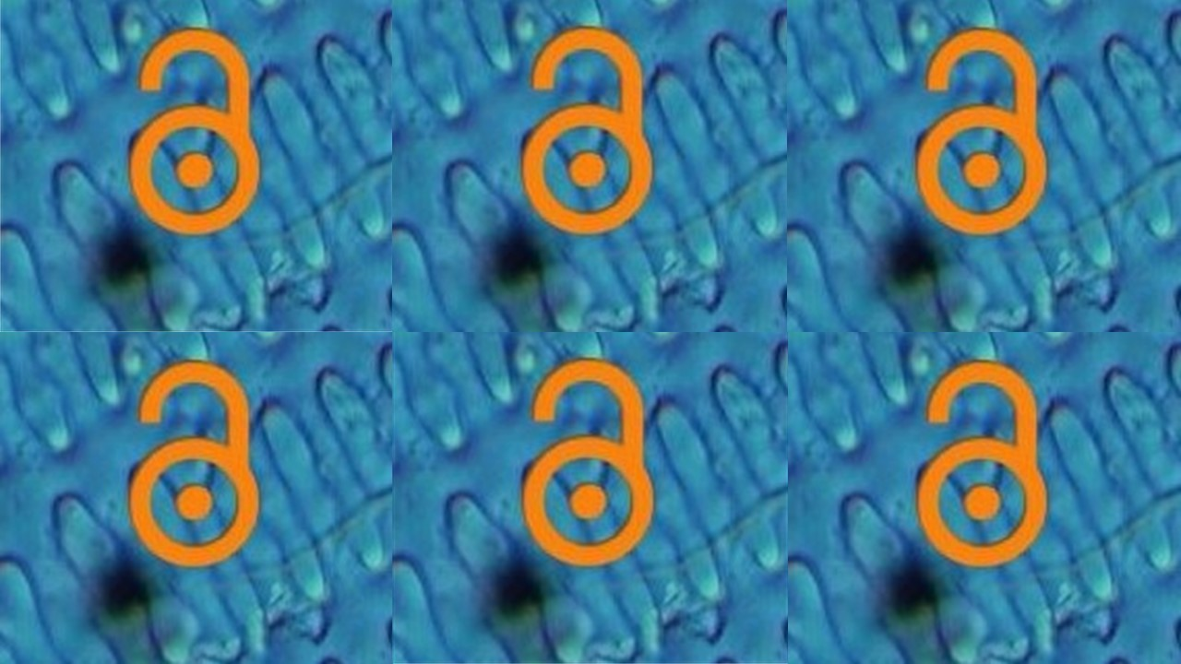

Open Access Publishing
EOSC-Life has received funding from the European Union’s Horizon 2020 programme under grant agreement number 824087.”
@open_phytoliths,
slides on Zenodo: https://doi.org/10.5281/zenodo.7669467
Notes:
Emma to start - press record.
See this longer talk - https://docs.google.com/presentation/d/1Ry7-MJfTPej3gHcta9pL4wIgz1-y6HiCi_2oiFq6xf8/edit?usp=sharing

Slide 2
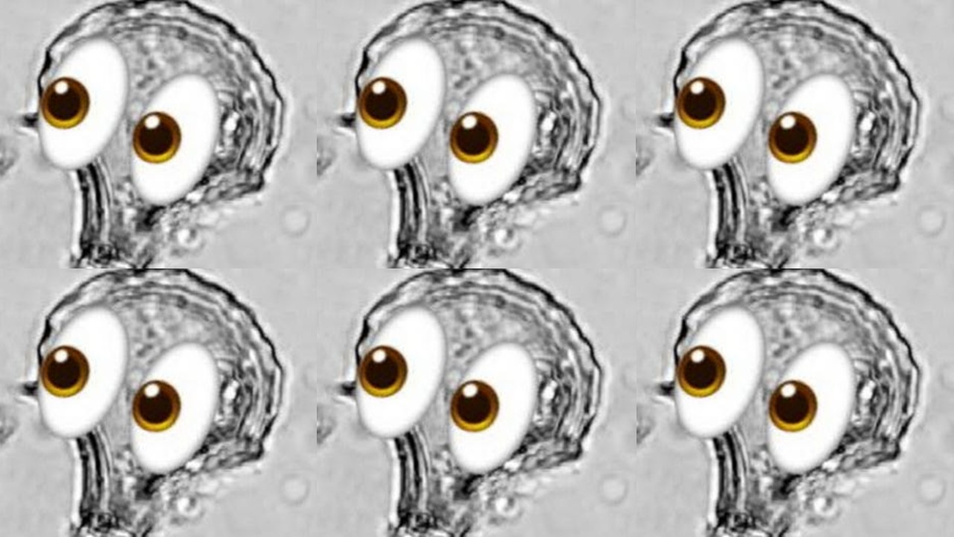



Connect with us!
Open Phytoliths Community
Please join our Slack workspace here: https://join.slack.com/t/openphytoliths/shared_invite/zt-1akxgco84-cz4Dii0Q5gXeb9J49UgYoQ
Join our mailing list: complete this form.
Take a look at our NEW multi-lingual website!: Open Phytoliths (open-phytoliths.netlify.app)
We are also on twitter (Open Phytoliths (@open_phytoliths) / Twitter) and facebook (Open Fitolitos | Facebook)!
📧📧📧
💻💻💻
Notes:
Thanks for listening and please do connect with us on slack, join our mailing list, take a look at our website or follow us on twitter or facebook.

Slide 3
Live translation instructions
Instrucciones de traducción en vivo
🌐
🌐
Click the Interpretation button on the zoom bar at the bottom.
Click on the language you want - Spanish or English
Haga clic en el botón Interpretación en la barra de zoom en la parte inferior.
Haga clic en el idioma que desee: español o inglés.

Slide 4
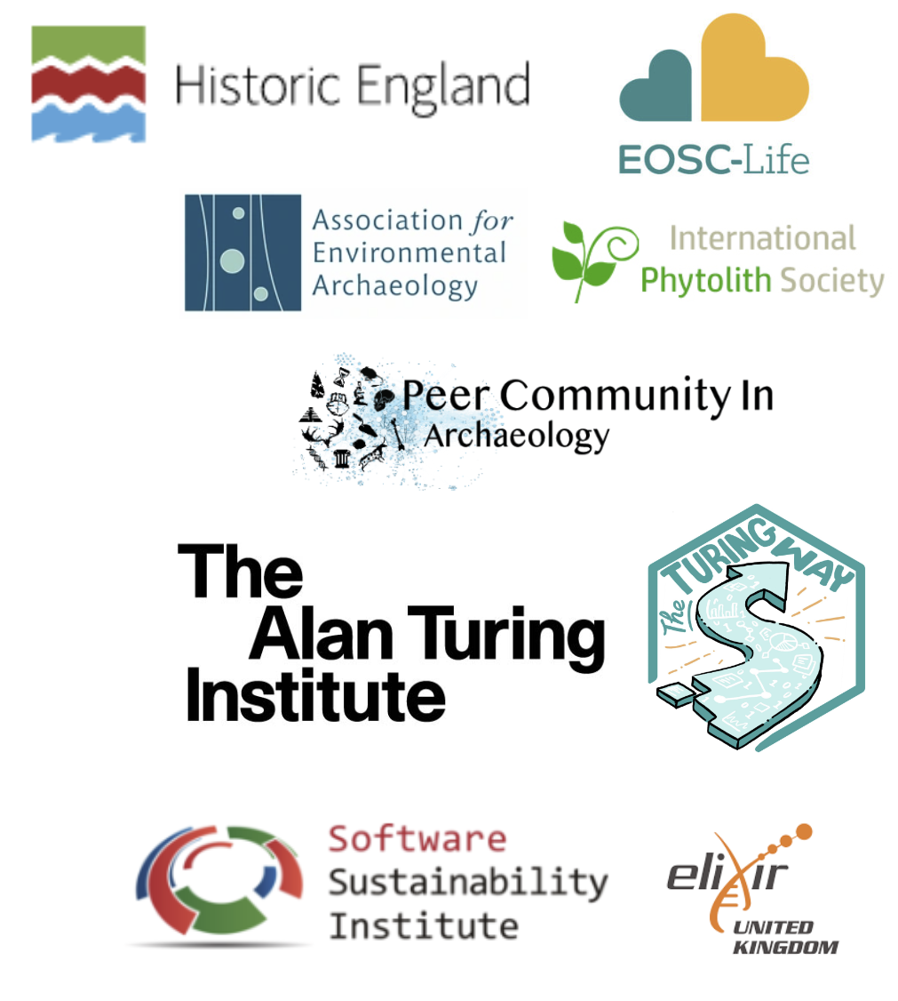

Introductions
Dr Emma Karoune:
Research Associate at Historic England
FAIR Phytoliths Project - PI
International Committee on Open Phytolith Science - Chair
Open Researcher at The Alan Turing Institute
Open access
Open collaboration
Reproducible workflows
Data science education
Fellow
Software Sustainability Institute
ELIXIR-UK FAIR Data Fellow
Notes:
Links for Emma:
Home | FAIR Phytoliths (open-phytoliths.github.io)
Digital Life Sciences Open Call - EOSC Life (eosc-life.eu)
Open Phytoliths (open-phytoliths.netlify.app)
https://envarch.net/
Emma Karoune | The Alan Turing Institute
Record of Contributions — The Turing Way (the-turing-way.netlify.app)
Emma Karoune | Software Sustainability Institute
Emma Karoune • ELIXIR-UK (elixiruknode.org)
https://orcid.org/0000-0002-6576-6053

Slide 5

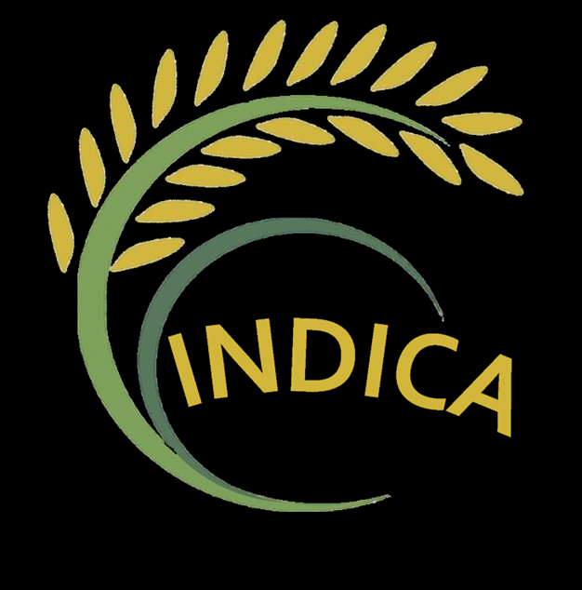


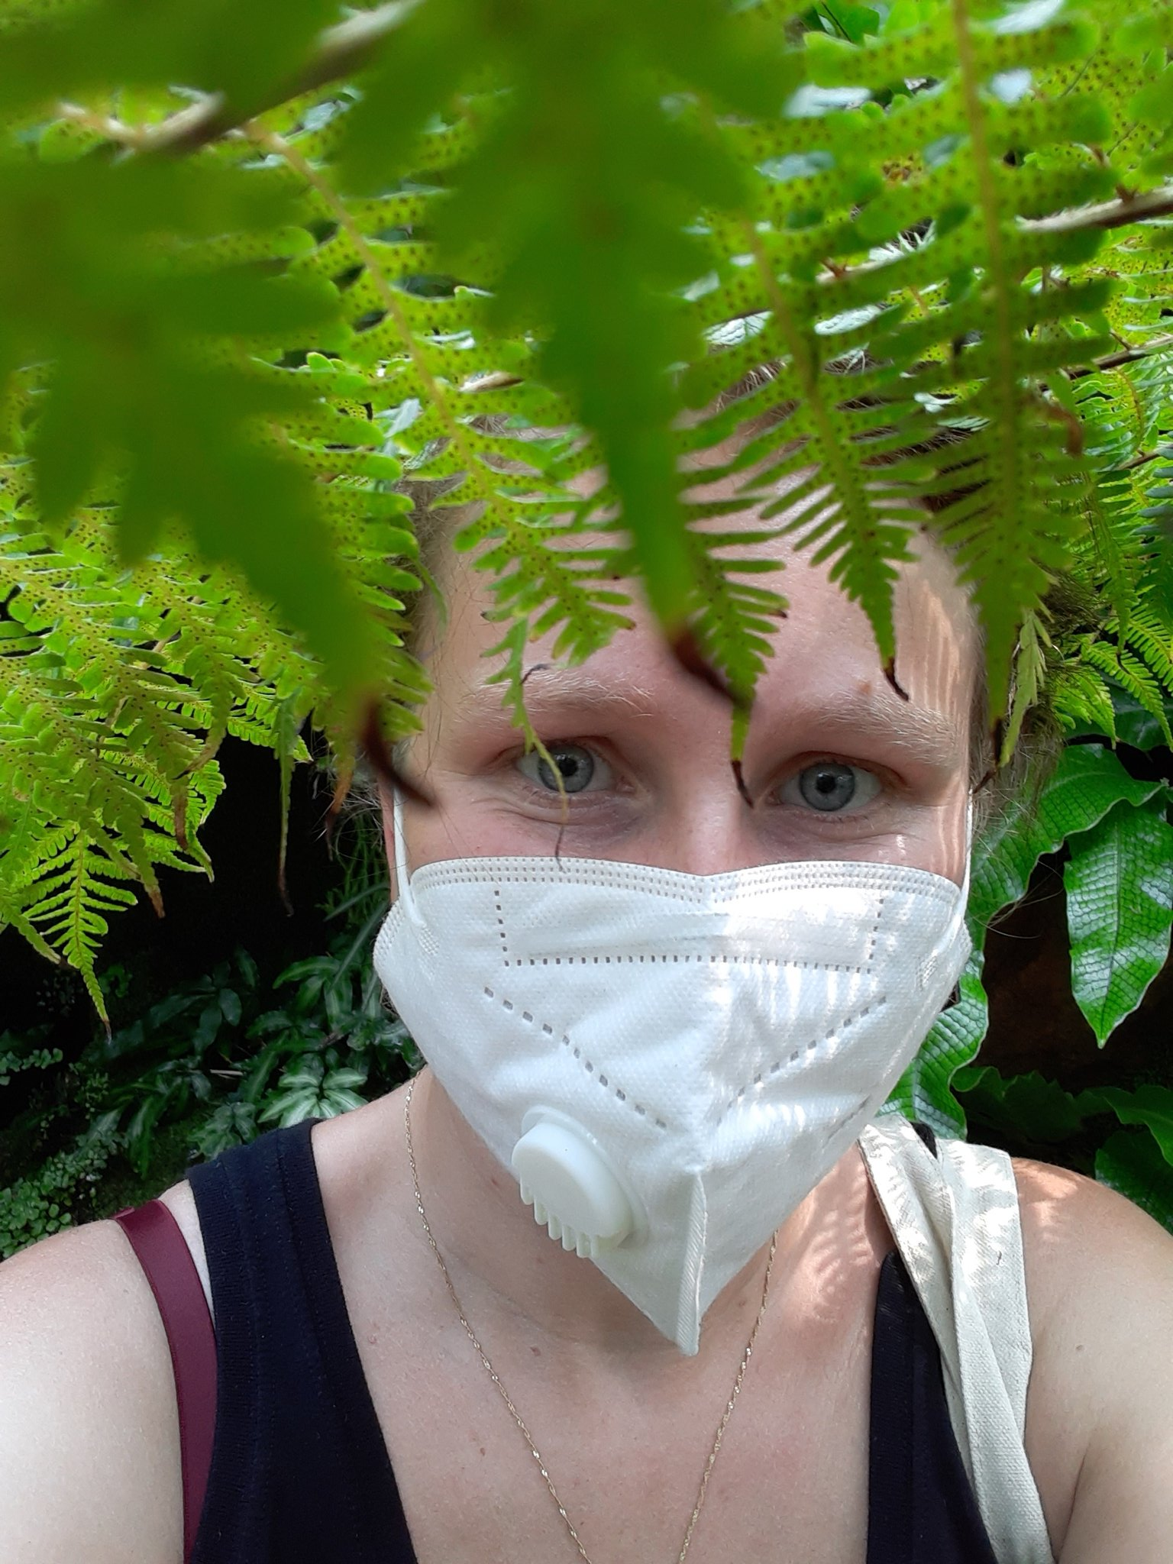


Introductions
Prof. Jennifer Bates
Assistant Professor of Archaeological Science at Seoul National University
Indica Project - PI
LC6k Project KWG - PI
Ashmounds Project - PI
Archaeobotanical consultant - EHLTC, Ur, Farmana/Rojdi projects
Visiting Scholar
UCSD
Research/teaching Areas
South Asian pre/proto-history
Archaeobotany
Archaeological methods
Notes:
Jennifer’s links:
http://www.archaeology-arthistory.or.kr/?c=user&mcd=saa0005&me=bbs_detail&idx=17773&cur_page=1&sParam=
https://snuarchsci.com/
https://orcid.org/0000-0002-7100-4741
https://snu-kr.academia.edu/JenniferBates
https://www.researchgate.net/profile/Jennifer-Bates-9

Slide 6
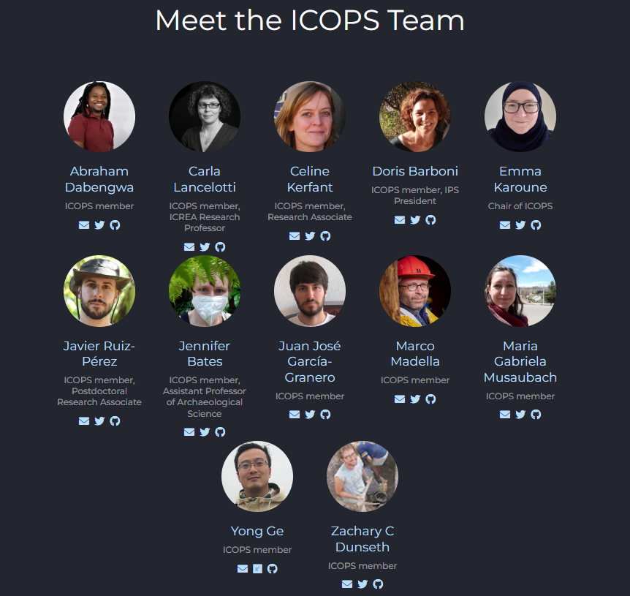

International Committee on Open Phytolith Science (ICOPS)
Countries
UK, Spain, USA, Argentina, India, South Africa, South Korea, China.
Affiliation
The Alan Turing Institute, Universitat Pompeu Fabra, Spanish National Research Council, French Institute Pondicherry, Brown University, National University of Jujuy, Seoul National University, University of the Witwatersrand, Texas A&M University, University of Chinese Academy of Sciences.
Yong Ge
Notes:
The international committee on open phytolith science or icops is a committee of the international phytolith society.
We have 12 members of the committee and we cover the world. We meet regularly to have discussions and work together.
Our goal is to increase the knowledge of and implementation of open science practices in phytolith research.
We have several initiatives going at the moment including - firstly the FAIR Phytoliths project, which is looking at how the FAIR data principles could be implemented in phytolith research, secondly we are starting to develop of a phytolith ontology, and thirdly we are doing this programme of training workshops.
We also built a multi-lingual website last year so you can read more about these initiative on there - the link is in the shared document.

Slide 7
Code of conduct
No harassment
Verbal and text comments that reinforce social structures of domination related to gender, gender identity and expression, sexual orientation, ability, physical appearance, body size, race, age, religion or work experience.
Use of sexual or discriminatory imagery, comments, or jokes
Deliberate intimidation, disruption
Unwelcome sexual attention
Advocating for, or encouraging, any of the above behaviour
Yes!/encouraged
Show empathy and kindness toward others
Be respectful of differing opinions, viewpoints, experiences and technological choices
Give and gracefully accepting constructive feedback
Take responsibility for mistakes and any impact on others, learn from the experience
Taking breaks to recharge!
If the Code of Conduct is violated you will be asked to stop or leave the space.
Please contact us about any violations: Emma Karoune (ekaroune@googlemail.com), Celine Kerfant (celineemmanuelle.kerfant@upf.edu).

Slide 8
Open Access Publishing
@open_phytoliths, slides on Zenodo: https://doi.org/10.5281/zenodo.7669467
Notes:
See this longer talk - https://docs.google.com/presentation/d/1Ry7-MJfTPej3gHcta9pL4wIgz1-y6HiCi_2oiFq6xf8/edit?usp=sharing

Slide 9
Learning objectives
Learning outcomes
What we are learning about in this workshop
To explain the difference between open access options.
To demonstrate the range of research outputs that can be made open access.
To understand the difference between open access options.
To know the range of research outputs that can be made open access.

Slide 10
What we are doing in this workshop
Introduction to open access publishing
Types of open access publishing
Benefits of open access publishing
Examples of open access publishing journals and platforms
Types of outputs that can be published
Demonstrating open access publishing
Showing how a reproducible/fully open articles are published and all the different outputs that are linked to it and how to do this
Exercise - Discuss and explore open publishing giving examples of different articles that show how open publishing works.
Notes:
We will pick those that show data and code deposited in repositories and also that use of protocol.io for publishing open methods.

Slide 11
Open access - what is it?
Open access (OA) = research outputs are distributed online, free of cost or other access barriers.
Gratis open access = immediate, permanent online access and free for all on the web.
Libre open access = free of charge to access, plus under open license (free to re-use).
Focus on peer reviewed research articles
Also other publications types - books, conference papers, theses, research reports, and more.
Other outputs too! - data, software, blogs, podcast, etc
Notes:
So what is open access?
Open access (OA) is a set of principles and a range of practices through which research outputs are distributed online, free of cost or other access barriers.
Gratis Open access allows immediate and permanent access to research outputs free online but Libre open access is the same but is also when the outputs have an open license for copyright and therefore are free for re-use.
The main focus of the open access movement is "peer reviewed research literature."
This is centered mainly on academic journals. Whereas conventional (non-open access) journals cover publishing costs through access tolls such as subscriptions, site licenses or pay-per-view charges, open-access journals are characterised by funding models which do not require the reader to pay to read the journal's contents or they rely on public funding - it is the author or the authors funder that pays the article publishing charge.
Open access can be applied to all forms of published research output, including peer-reviewed and non peer-reviewed academic journal articles, conference papers, theses,^{[3]} book chapters,^{[1]} monographs,^{[4]} research reports and images. It also refers to data, and software.

Slide 12
Not only research articles!
Project ideas/design
Data collection
Data analysis
Reporting
Review
Open-source project
Training materials
Open peer review
Data + Metadata in open repository
OA research paper /
data paper
Citizen science
Funding application
Community review
Pre-registration report
Blogs, videos, website
Blogs / lay summaries
Open code
Talks and training to wider community
Open peer review
Open field notes/ lab book
Research compendium
Pre-print/
post-print
Talks to wider community groups
Academic social media
Conference talks
Notes:
But it is not only research articles that we can publish: there is a whole spectrum of research outputs that can be opened up and published throughout the research lifecycle.
This includes writing blogs and making videos or podcasts to open our research up to wider audiences, writing data papers to enable the FAIR deposition of research data, and having open-source projects that show complete transparency of research as it happens.

Slide 13

Why Open access?
Visibility and discoverability
The carrots for increasing accessibility
Transparency -> Reproducibility
Validation -> research quality
Sustainability
Inclusivity
Diversity
Notes:
So why would we want to make our research open access?
Some carrots, so incentives, for increasing the accessibility of our research are:
Making your work openly available makes it more readily visible and discoverable - others can actually download and read it - not just the abstract.
Your work is more transparent - other can understand fully what you have done and reproduce your research using your data and analysis steps.
Thorough validation can happen by peer reviewers but also wider community - this can happen in the pre-print stage - leading to greater research quality.
With greater accessibility and transparency of research it make research the more sustainable. More researchers can reuse and build upon your research.
More accessibility means you are including more people in your research - this include other researchers, the wider scientific community and the general public.
This in turn allows for a greater diversity in our research community and more broadly greater diversity in those that interact with and benefit from research.

Slide 14

Why Open access?
Funders require open access
The sticks for increasing accessibility
New! Open access policies of funders are increasingly requiring articles and other research outputs to be open access.
UK Research and Innovation
European Research Council
National Science Foundation, USA
Australian Research Council
Open access India - draft policy
Do you know a policy from your country? - please share the link in our shared doc
Notes:
It is gradually becoming mandatory that we make our research outputs open access.
Funders in different countries and regions are now requiring immediate open access for publications and also outputs linked to these publications. These funders include UK Research and Innovation, Europe Research Council, federal funders in the United States and the Australian Research council. There is also a draft policy in India.
I would be interested to know if your country also has such a policy so please do add a link in our shared document or in the chat.
Even if your funders don’t yet say it is mandatory - making your research open access demonstrates you know this is the way science is moving.

Slide 15
Why Open access?
Funders require open access
The sticks for increasing accessibility
Institutions require open access
Do you have an institutional policy on open access?
Historic England - archives access policy
Research integrity policy - open communication of research
Notes:
Some institutions also have policies that require outputs to be open access.
Both the institutions that I work for have policies that cover how research should be published and they mandate open access for all research outputs where possible.
You can see the links to the policies from Historic England on this slide.
So have a look at your institutions policies if you are not sure whether you are mandated to do this or not.

Slide 16
Why Open access?
Funders require open access
The sticks for increasing accessibility
Institutions require open access
Some journals are now OA only & others are hybrid
Check author requirements for data and code sharing
Example from PLOS One - data availability policy
Journals policies
Notes:
There are also an increasing number of open access only journals that therefore require gold open access and have strict policies about open access to linked research outputs such as data.
Many hybrid journal’s now have author policies that require you to make your research outputs linked to articles open access.
I have given an example of the data availability policy from PLOS One - this is a journal that archaeologists and palaeoscientists often publish in and it requires authors to make all data necessary to replicate their study’s findings publicly available without restriction at the time of publication unless legal or ethical reasons exist.
It also says you must write a data availability statement and we are going to go through those later in this session.

Slide 17
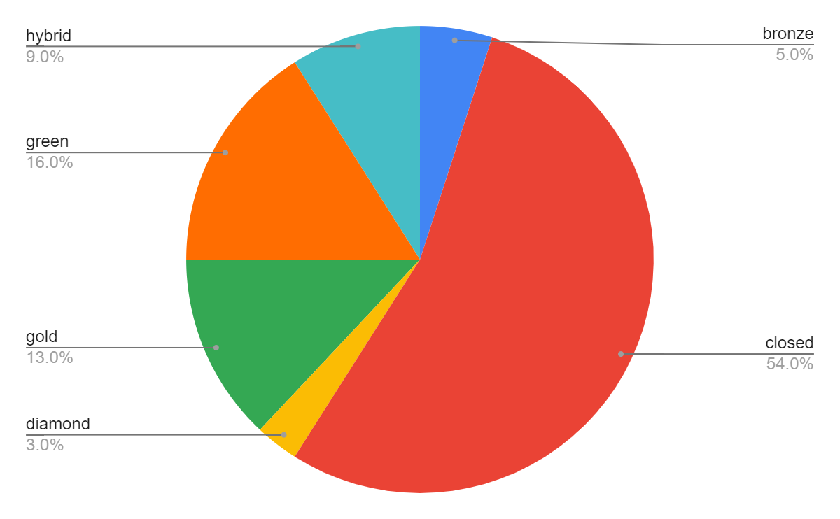
Why do phytolith researchers need to increase open access?
Few of our publications are open access
Most of our data is in articles or supplementary files
Global community - not everyone can afford journal fees
54% Closed
All others here are some form of open access = 46%
Notes:
Few of our publications are open access
FAIR Phytoliths project - we looked at 100 phytolith publications and found only 46% of the articles were open access, so that means over half were closed access.
We also know from previous work that most of our data is found inside articles or supplementary files, So if most of our articles are closed access this means the data in these articles is not accessible.
We are also a global community and not everyone can afford journal fees to access the closed publications, so we need to make all our research articles open access to allow all researchers access to this research.

Slide 18
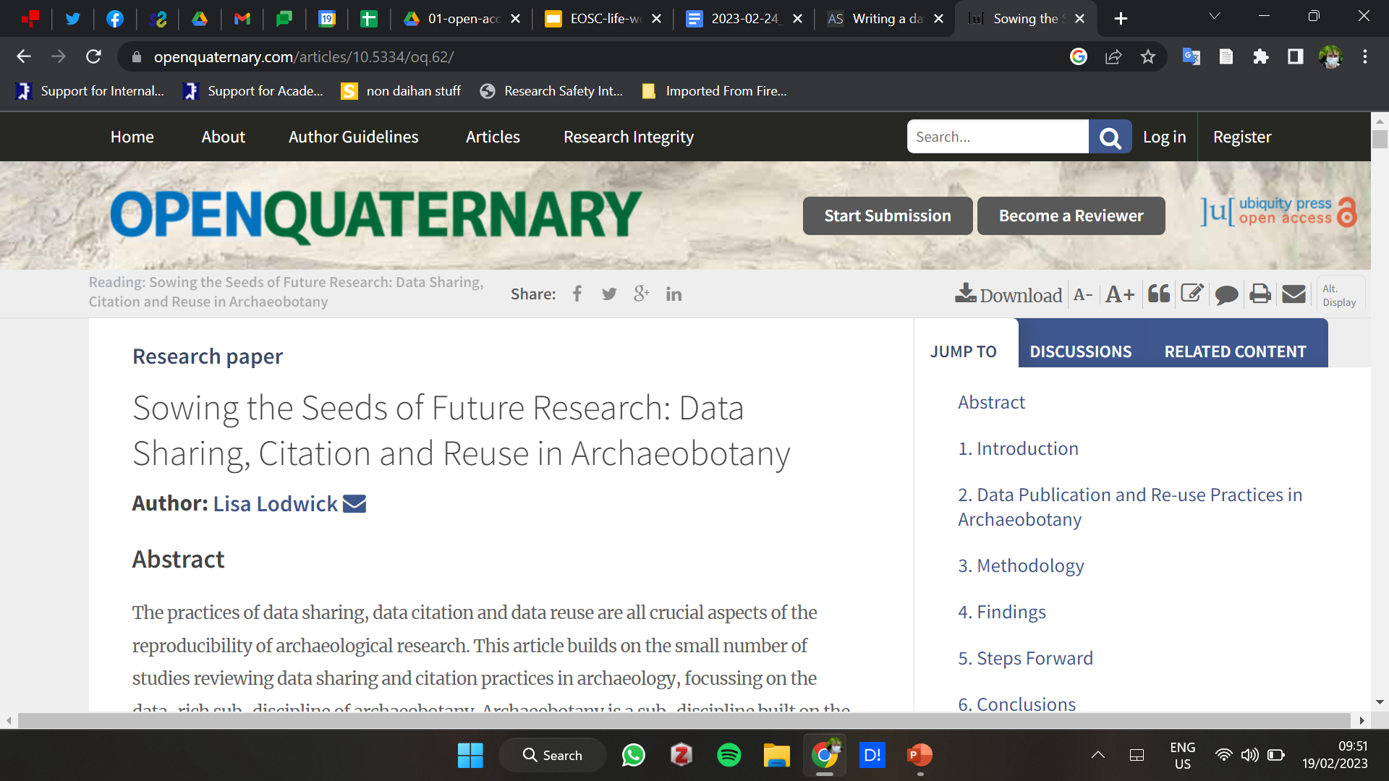
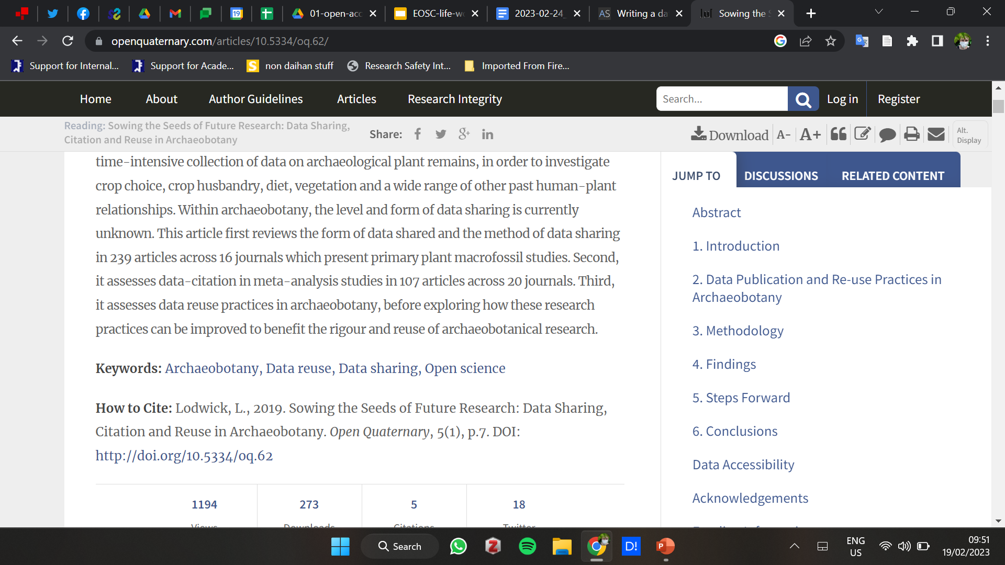
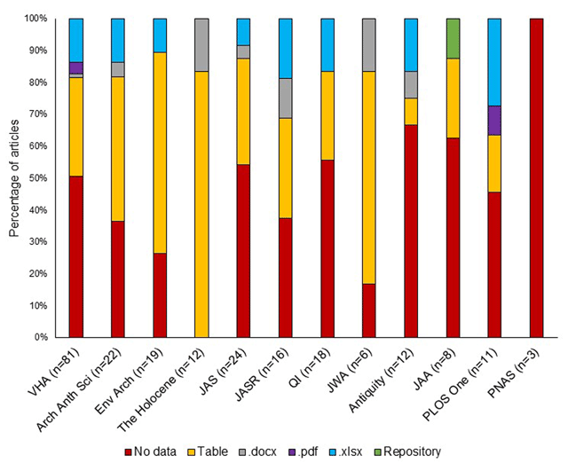
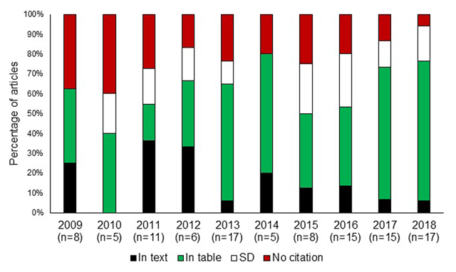
Figure reproduced under CCBY4.0
Chart showing the location of data citations in meta-analysis journal articles from 2009–2018.
Chart showing the location of primary archaeobotanical data by journal in primary archaeobotanical data publications.
Notes:
This is a small point that leads to our next workshop next month - SIs and repository links, if they are not persistent links, can goes walkies, so we have to be careful to ensure the data sharing approaches are secure.
Lisa Lodwick’s paper notes that even with open publishing in archaeology, specifically archaeobotany, there have been numerous instances of data going missing particularly when just as an attached SI uploaded only to the journal submission system.
After looking at 256 articles in 16 journals related to archaeobotany she realised that only 56% of articles shared their primary data, this also varied according to journal - I seriously recommend reading the paper for the details - and that frequently when data was available it was either in tables embedded in the text, so summary format, or as a proprietary format document attached as an SI, rather than in open access repository form.
Whilst supplementary data tables are a common option for sharing data, these contain problems of a lack of peer-review, lack of curation compared to the main article, and link decay. Several articles reviewed here had missing supplementary data files which should have contained the raw data. However, the use of supplementary data files is often promoted by journal editors to save the word count of articles. There are other issues she highlights: This often places data behind a paywall, inaccessible to those not working for institutions (typically universities) which subscribe to journals, does not guarantee the long-term preservation of data, and does not enable content searches just for datasets.
SO it is worth considering your data as well as as articles when making FAIR and OPEN publishing strategies, and not just in terms of the final data sharing policies, but from the beginning when structuring the paper.

Slide 19
Benefits of increasing open access/open publishing
For our wider community
For you
Increased quality of research
Increased collaboration in our community
More sustainable research for the next generation
More diverse and inclusive research community
Increased citations of your published research articles.
Greater discoverability and enhanced visibility of your work.
Credit for all your work.
Notes:
You might be thinking - how is this going to benefit me to make my work open access?
Well there are two groups of benefits
Firstly those for the wider community
Making our work more accessible and transparent leads to increased quality of research.
It also increases collaboration in our community as more researchers read each others research and find common interests.
Our research becomes more sustainable for the next generation to build upon
And giving more access to research means our community becomes more diverse and inclusive
Secondly personal benefits are:
It can increase your citations - I will give more details about this on the next couple of slides.
Your work is more discoverable and visible generally raising your profile as a researcher
And this means you get more credit for all your work including the wide range of outputs you make accessible not just journal articles.
OA citation advantage - https://doi.org/10.1371/journal.pone.0253129
Data citation 25% - https://doi.org/10.1371/journal.pone.0230416

Slide 20
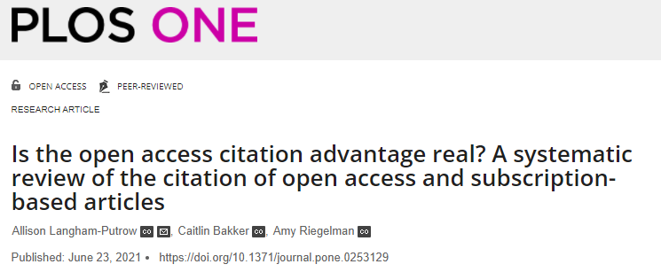
Higher citations for open access papers
76% of studies found Open Access Citation Advantage
https://doi.org/10.1371/journal.pone.0253129
Notes:
So what evidence is there for this?
In terms of more citations.
There have been many studies to show the higher citations for open access papers, but also some that show no advantage.
This study looks at these studies and found that overall there was an advantage to OA - 76% of studies found some increase in citation from using open access.
OA citation advantage - https://doi.org/10.1371/journal.pone.0253129
Data citation 25% - https://doi.org/10.1371/journal.pone.0230416

Slide 21
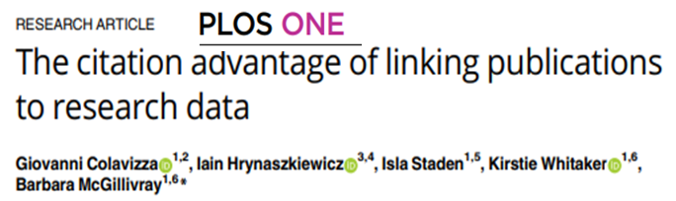
More citations if you link data
25% higher citation impact for papers that include a link to data in a repository
Notes:
There is also this study that shows 25% higher citations for papers that include a link to data in a repository.
They considered 531, 889 journal articles published by PLOS and BMC (biomed central).
OA citation advantage - https://doi.org/10.1371/journal.pone.0253129
Data citation 25% - https://doi.org/10.1371/journal.pone.0230416

Slide 22
Types of Open Access
Type | Open where? | When? | Who pays?
Gold | Publication/ Journal | Immediately on publication | Author - funder/institution
Green | Open repository | Immediate | Free
Bronze (restricted re-use) | Publication/ Journal | Embargoed or immediately | Author - funder/institution
Diamond | Publication/ Journal | Immediately | Professional society
Platinum | Publication/ Journal | Immediately | Institution or funder
Black | Social media/Sci-hub | Immediately | Free but illegal
Notes:
So let’s now learn more about the different types of open access.
There are lots of different ways to make your research outputs open access and this does not have to come at a cost. It is therefore a misconception that you have to always pay to make your research open.
Please see the table on this slide for more details about the different types of open access. These are often talked about as referring to journal articles but actually apply to how we go about making all research outputs accessible.
Gold open access is when you, as the author, pay a fee to make your article or other research outputs open immediately and free to read, and if possible, available for reuse.
Bronze is like Gold where the author pays the fee but has restricted rights to reuse of the article and it’s content. It can also be embargoed access so there not openly accessible immediately but after say 6 months.
Green open access is where you use a pre-print server or open repository to deposit a version of your article or other research outputs - this does not come at a charge to you or to the reader.
Diamond and platinum are when publications are free for the author to publishe and also reader to access - the cost of this is covered by a professional society or institution.
I also want to highlight black open access - many researchers upload final published versions of articles to academic social media sites such as Research Gate or Academia but this can be in breach of the copyright.
You also need to be careful when using sites like Sci-Hub to access research articles as this is also an illegal act.

Slide 23

How can you publish a gold open access journal article?
Pay Article Processing Charge
Include cost on funding
Ask your institution for funds
Some Institutions have publisher deals for Gold OA
Shop around for the best deal!
Ask for a fee waiver
Apply for a grant
Notes:
In phytolith research, we are publishing less than half of our articles as open access so how can we increase this.
If you want to publish Gold open access then how can you go about that.
It costs money to have your article open access immediately when published - this is gold open access and it comes with an APC or article processing charge. The APC varies a lot from many thousands of dollars in the highest impact journals such as Science and nature, to only a few hundred in others.
Here are some ways that you can go about publishing gold open access:
Think ahead when you are applying for funding and include the APC cost.
Ask your institution for the money - there may be left over budget or they may have an open access fund.
Some universities or institutions have deals with publishers for gold open access - most institutions are in a transitional stage between a subscription model of access to journals and open access to research literature.
“Transformative agreements” attempt to shift institution spending on scholarly resources away from a subscription model of access towards open access publishing. Other names for them are read-and-publish deals, publish-and-read deals or transitional agreements.
You can check on your institutions website to see what deals they have with publishers.
You can also shop around for the best deal as not all journals charge the same amount.
With all journals you can ask for a APC fee waiver - this means you would get open access for free if it was accepted. You do this by asking the editor in your letter of submission. They then respond to you in the review stage of your article.
There are also some journals that have grants to cover the open access charge like the journal internet archaeology.

Slide 24
Diamond and Platinum open access publishing
This is a good option if you can’t pay/fund gold open access.
Journals are supported by institutions or professional bodies to make them open access for authors and readers.
Some examples:
Documenta Praehistorica - https://journals.uni-lj.si/DocumentaPraehistorica/index
Journal of Indo-Pacific Archaeology - https://journals.lib.washington.edu/index.php/JIPA/index
Do you know any more? Share them in our shared document.
Notes:
Diamond and platinum open access journals are a good option if you can’t pay or fund gold open access.
These are journals supported by institutions or professional bodies to make them open access for authors and readers.
I have put some examples on the slide here.
Do you know of more journals like this? Please do share links on our shared document.
https://oa.mg/journals/open-access-archaeology-journals

Slide 25

Green open access publishing
It’s completely free!
What?
Pre-print
Post-print
Where?
Pre-print server
Open repository
⚠️
Check: If the journal allows it
Must not be journal final version
⚠️
Notes:
Green open access is completely free!!
Going through the traditional journal route of publishing and not wanting to or don’t have the fund to pay for gold open access - you can still make your article open access by self-archiving on a pre-print server or an open repository.
This can be done when you first submit your article to the journal - this is known as a pre-print as it is the version of the article before it has been reviewed.
Or you can deposit the post-print - the version of the article after you have gone through peer-review but when it hasn’t been formatted by the journal.
If you want to do this, you need to check with the journal’s policies whether they allow this - most journals do - and you also need to make sure that you deposit the correct version - not the final formatted version that you would see in the journal.

Slide 26





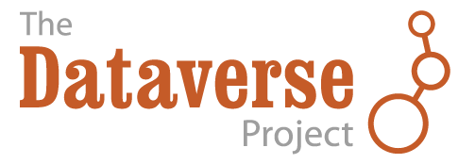

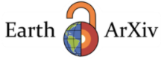


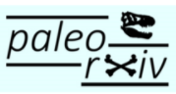
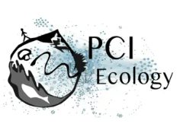
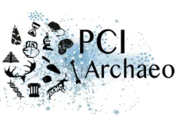



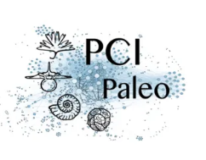
Different ways of making your outputs accessible
Pre-print servers
Open repositories
Peer review services
Notes:
There are many ways to make your research articles and other research outputs open access that do not require paid services from journals or repositories.
There are many free and open repositories that take any type of research output - examples here are figshare, zenodo, dataverse and open science framework.
You may also have a university or institution repository that you can use. These services give you a digital object identifier or DOI that can be used to cite your research output - this is a persistent identifier that permanently stores a link to that version of your research output. You can also put your own choice of license on your output to enable reuse.
For articles, you can deposit a pre-print on a pre-print server and there are many of these to choose from as you can see on this slide. These are all free to use.
There are also alternative publication routes such as Peer Community In or Open Research Europe. These systems enable pre-prints to be peer reviewed by experts in a discipline and then recommended - just like is done when you submit your article to a journal. This process creates a citable version of the reviewed article.
With Peer Community In, there are specific groups for archaeology, ecology and palaeo sciences that would be relevant to phytolith research articles. PCI is completely free for authors and readers.

Slide 27
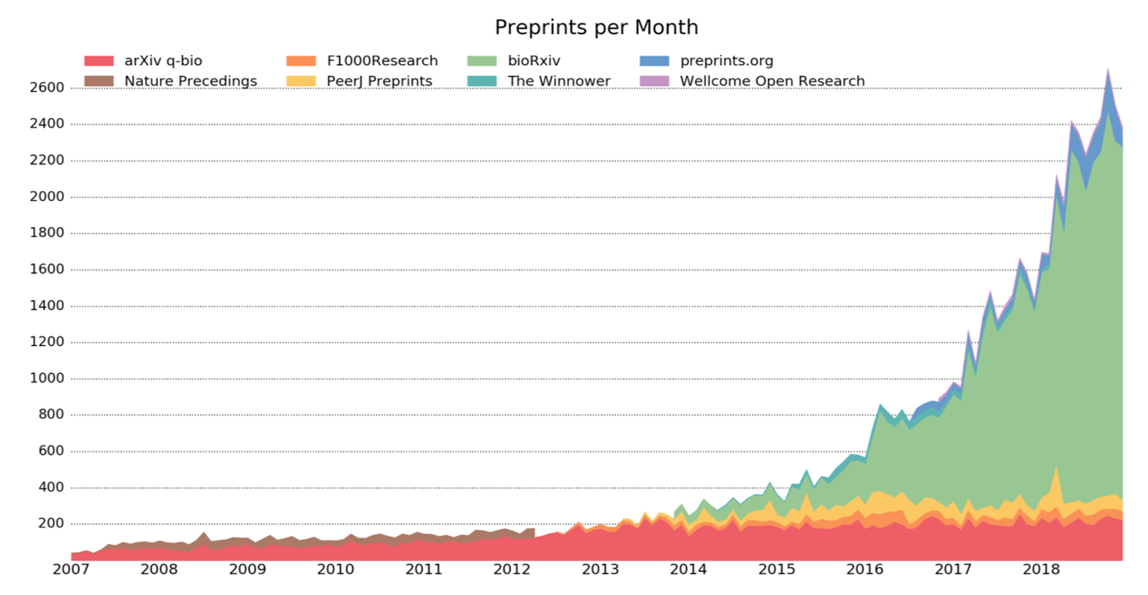

Pre-prints - new way to publish research quickly
Has become very popular in many disciplines
Quick way to get your research out there
Problem = no peer review
Although most pre-prints are submitted to journals
Notes:
In many disciplines there has been a very rapid rise in pre-printing. And as well as being a way to give everyone free access to your article, it gets your research out quickly.
The problem with this is that pre-prints are not peer reviewed - although most pre-prints are submitted at the same time of release to a journal so are reviewed, edited and then published in journals. The pre-print will remain as a version of the article and it will link to the reviewed versions of the article.
Peer community in archaeology video - https://www.youtube.com/watch?v=wQ0B2aQVc-Q&authuser=0

Slide 28
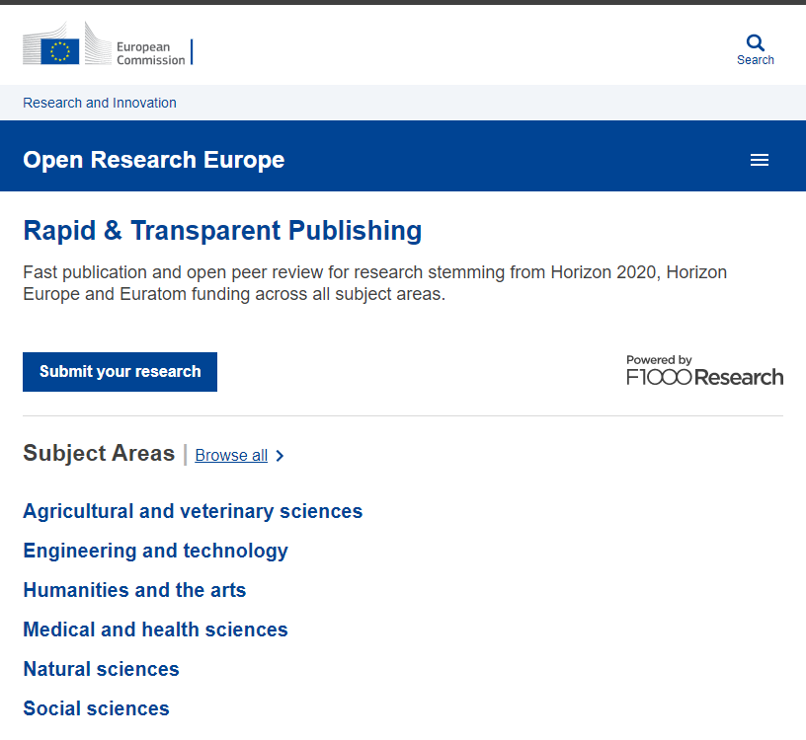
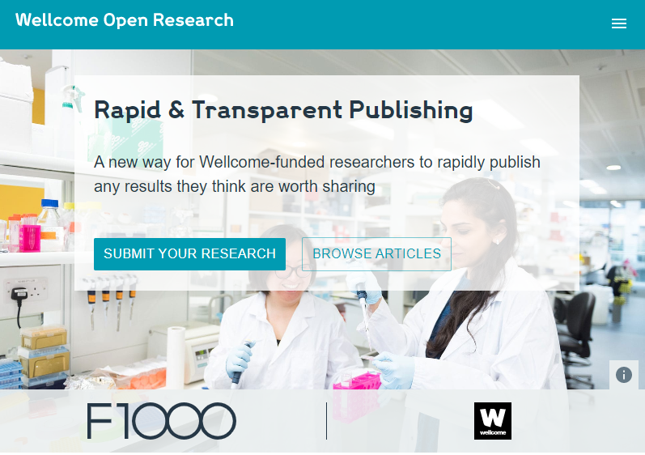
New non-journal peer review systems
Through funder platforms - Open Research Europe, Wellcome Open Research
Free for those funded by organisation
Uses F1000
Open review
Open data & code
Notes:
There are now alternative routes for publishing peer reviewed research that are not journals
Funders are now making platforms for open access research - examples are Open Research Europe and Wellcome Open Research - you have to be funded by those organisations to be able to freely have your research peer reviewed and archived on the platform.
They use an existing publisher workflow - in this case F1000.
They have open reviews - so you can see who reviews the papers and what they said about the articles and the changes made.
They also require open data and open code/analysis.

Slide 29
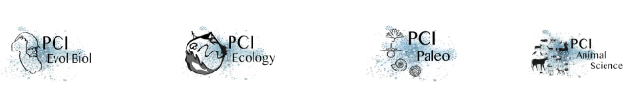
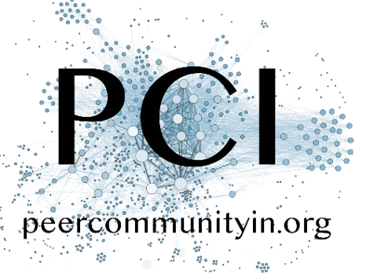

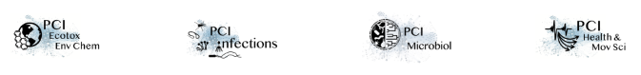
Peer Community In
It creates a community of researchers to evaluate preprints.
16 different domains
Free for authors and readers
Has to have open data and open code
Open review
Notes:
Another pre-print peer-review system is Peer community in.
This is a community of researchers that has been brought together to evaluate preprints, just as is done in journals. But there is no publisher and it is completely free!
There are now 16 different domains including archaeology, palaeo and ecology.
As i have said it is free for authors and readers.
Again you have to have open data and open code.
And it is open review.

Slide 30
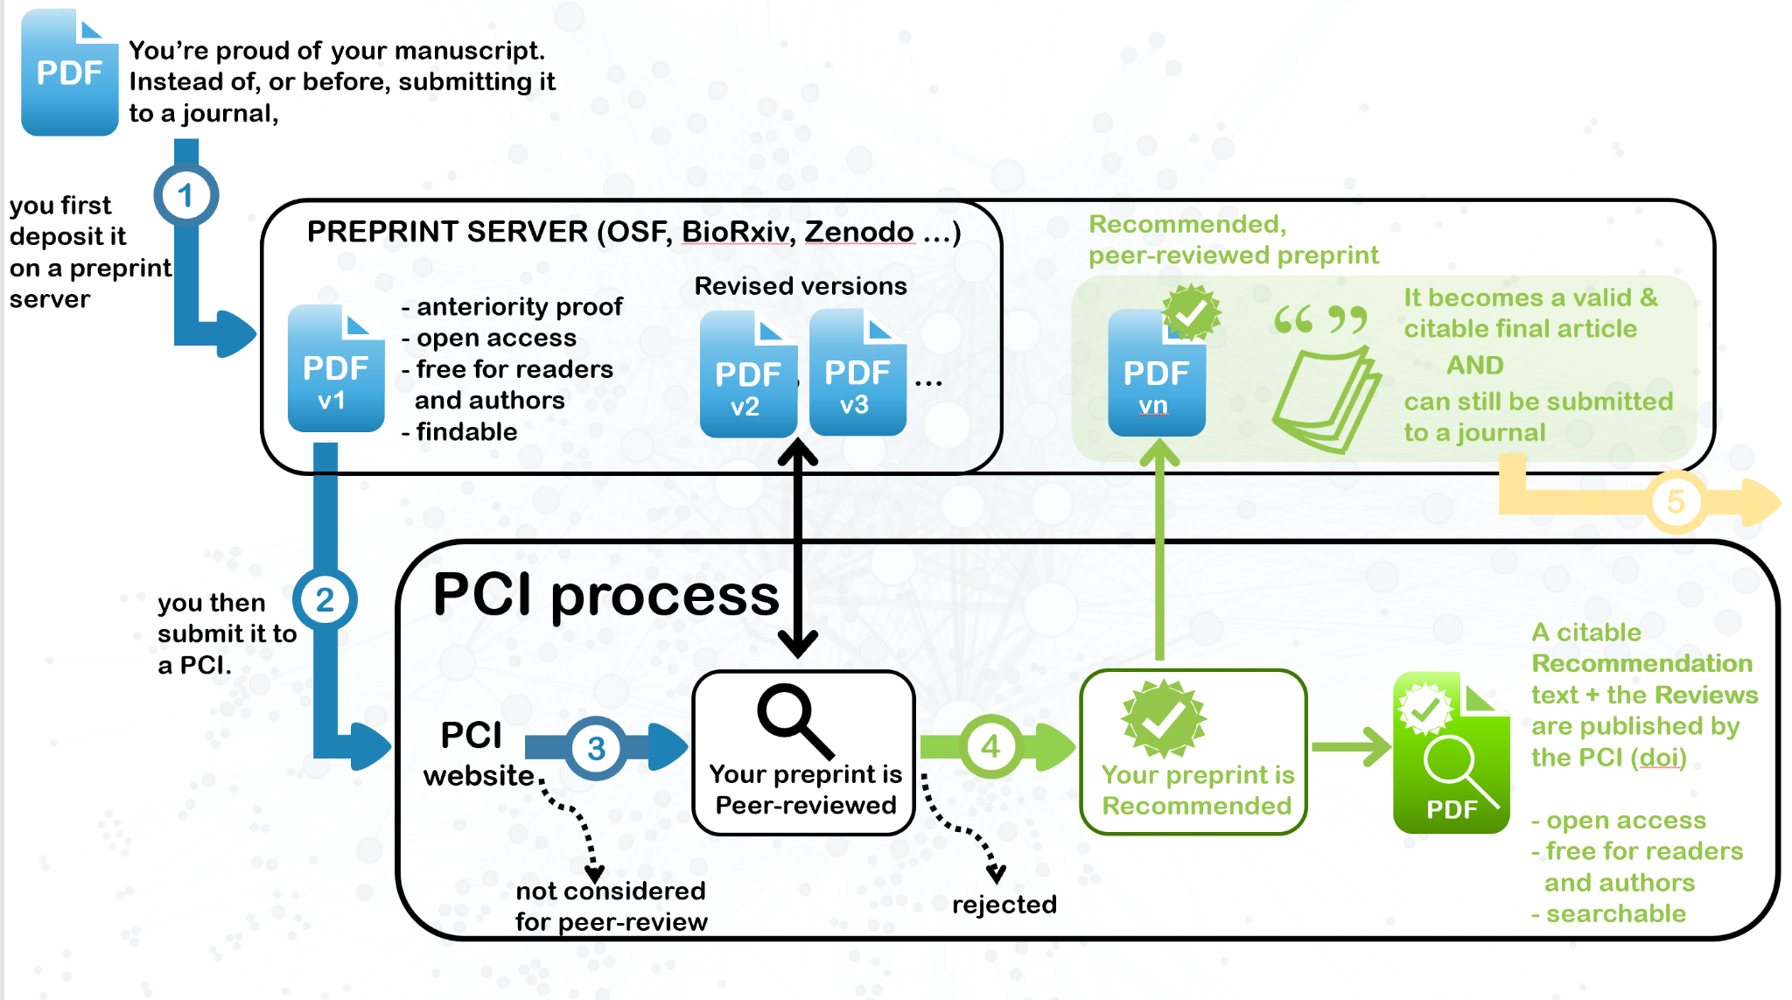
Notes:
How it works is:
You finish your paper and then you put it on a preprint server or open repository.
You then submit it to the peer community in you want it evaluated by.
They send it out to reviewers
You get the reviews back and edit.
If the article is then accepted, it is recommended - this is like the editor of a journal writing to say why they have accepted the paper.
You then format it to look like a journal article and the final version is put on the repository.
You can then send it to a journal - there are journals that will automatically accept the paper if reviewed in this way but most papers are not sent to journals as there is really no need.

Slide 31
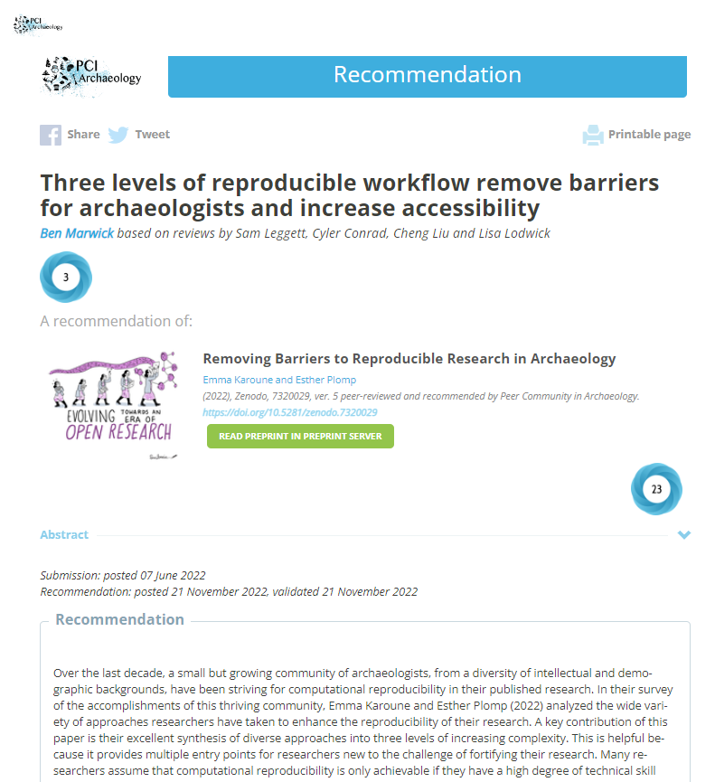
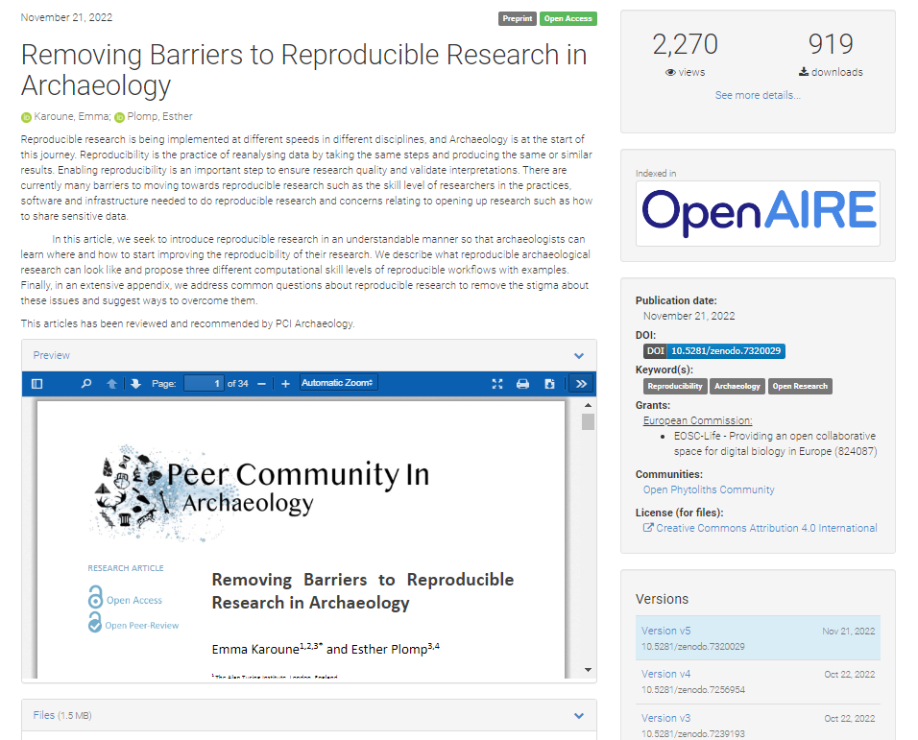
At the end of the peer review process
https://doi.org/10.5281/zenodo.7320029
Notes:
This is what it looks like - I have a recent article that has been published in this way.
On the left - this is the recommendation on the peer community in archaeology website
and on the right is the repository where the final reviewed and formatted article is.

Slide 32

If you don’t have access to journal articles
Unpaywall - https://unpaywall.org/
Open access button - https://openaccessbutton.org/
Research gate - to request articles
Email authors or other academics
Sci-hub
Notes:
Finally in this section
What do you do if you don’t have access to journal articles and they are not open access!
Unpaywall is a google extension that you can download and enable in your browser. It provides a button when you are on a journal page to tell you if there is a green open access version somewhere available and then if you click on it - it take you to that version.
There is also a website called open access button, which does a similar thing - it can tell you if there is another version. You can also do this if you search for an article on google scholar as it shows you different versions of articles.
Many researchers put articles on research gate - even if there is not an accessible article there, you can message the author to request a copy and normally you will get sent it.
You can email the author directly.
You might have a friend that has more access than you and they might be kind enough to send you articles.
And last is to use sci hub. Although of course I would not recommend that as it is illegal.

Slide 33

Questions????
Please put your hand up or write your question in the chat or shared document.
Notes:
Ok so we have got to the end of the introduction so it is a good point to stop and take any questions you might have at this stage.
Do remember though that we have not finished explaining and demonstrating open access so there is more to come.

Slide 34

Demonstration
Notes:
Jen to take over

Slide 35
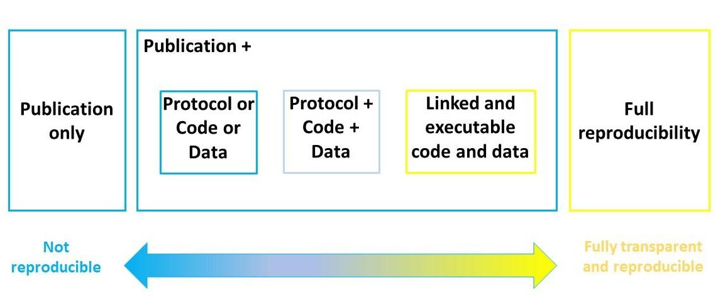
Moving towards open and accessible research
An adapted reproducible spectrum (Peng 2011) with the addition of protocols.
Karoune & Plomp 2022, Removing Barriers to Reproducible Archaeology, https://doi.org/10.5281/zenodo.6618672
Notes:
Publishing research is changing - we are now moving away from the stand alone research articles that just present results, interpretations and conclusions.
Research is moving towards being published in a reproducible manner.
This means stand alone articles are not sufficient.
Our articles need to link to all outputs generated in research such as data, code and methods. This makes our work more comprehensible and aids reuse of data and other research outputs.

Slide 36
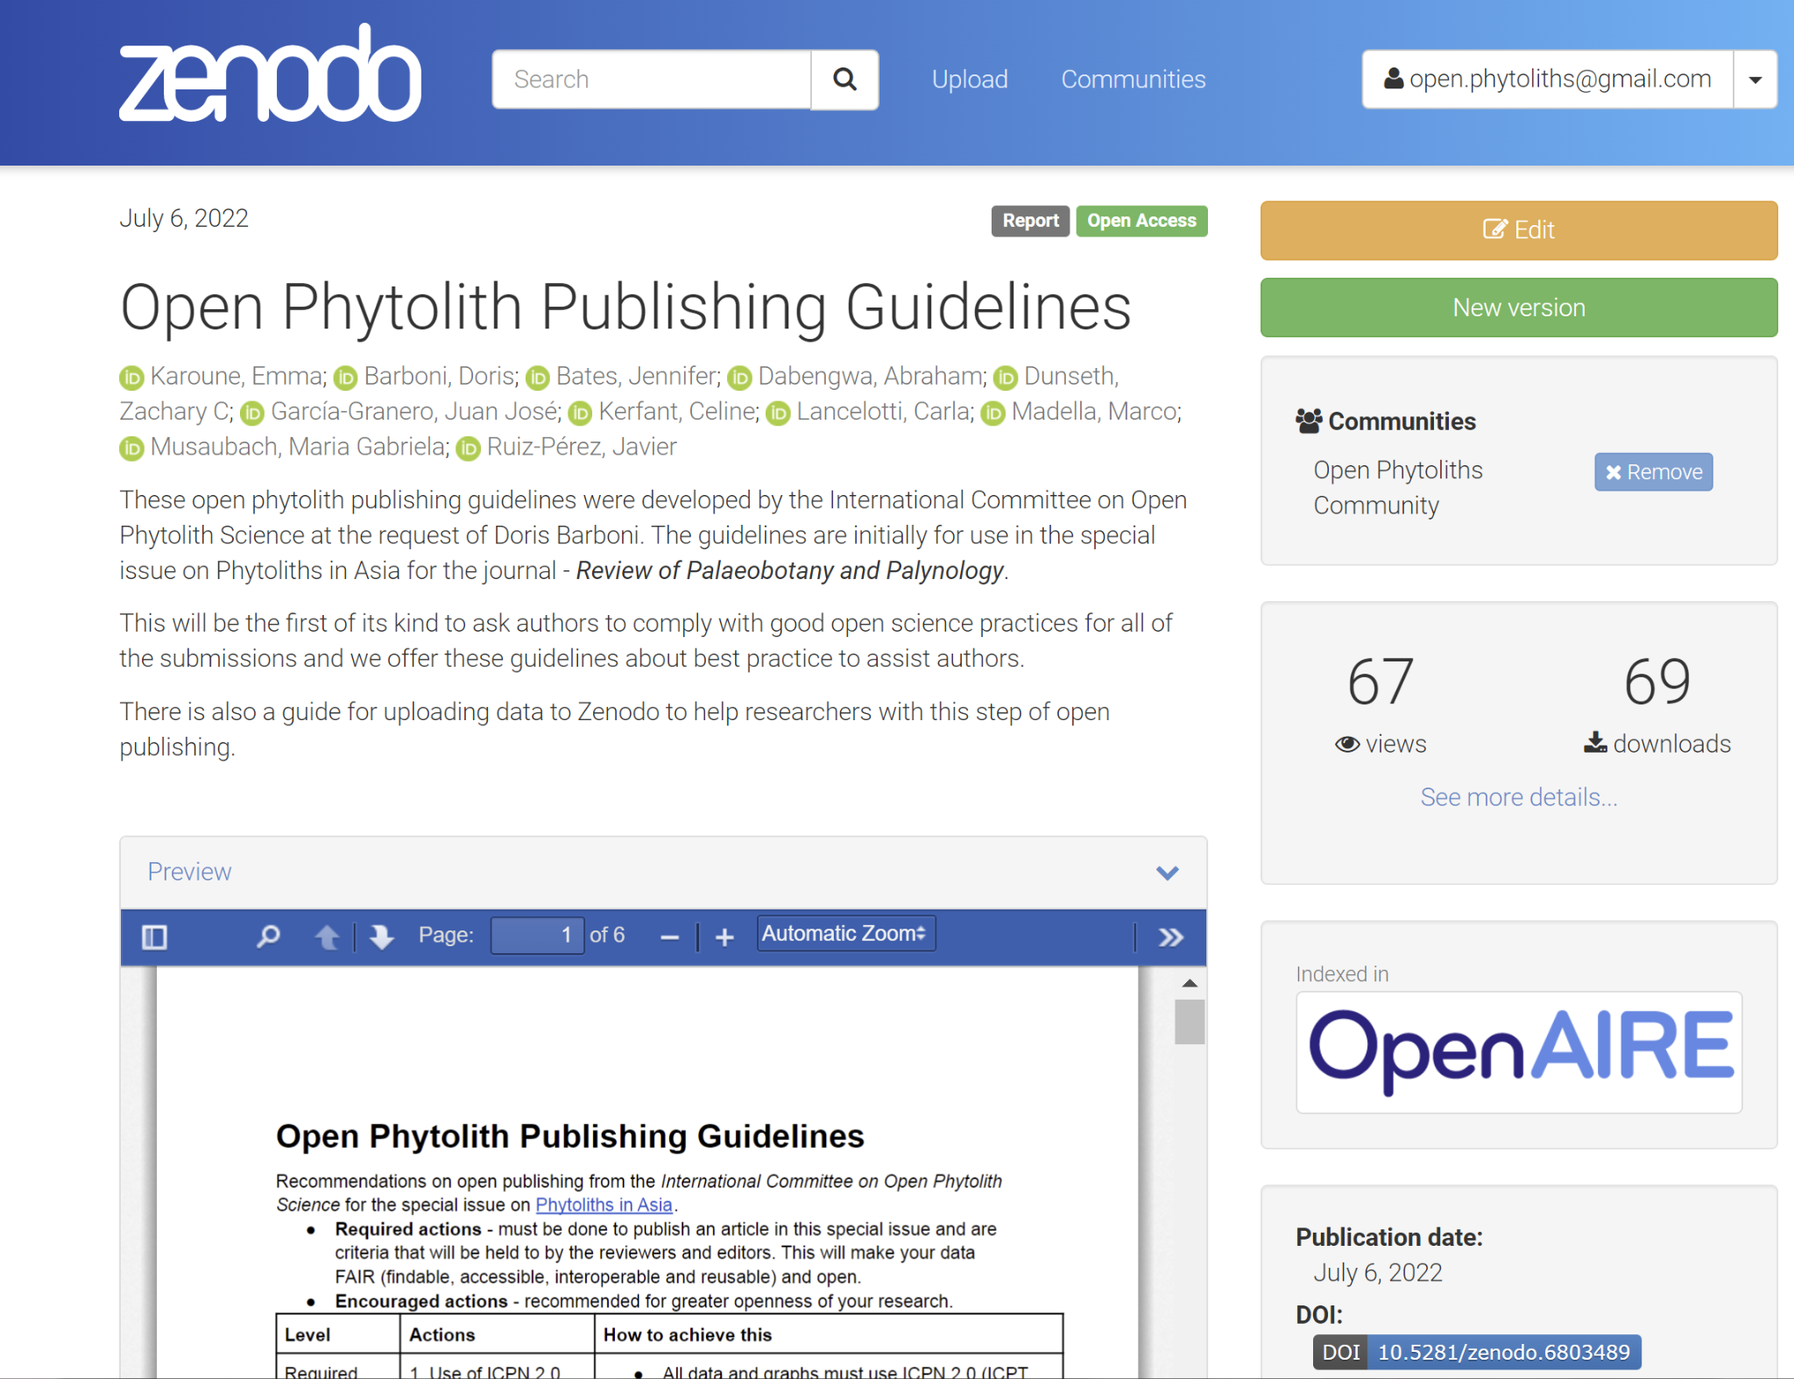
Open Publishing Guide
https://doi.org/10.5281/zenodo.6803489
Notes:
One of the initiatives that the International Committee on Open Phytolith Science have been tackling is drawing together a guide about open publishing in phytolith research.
You can access this guide on Zenodo. - https://doi.org/10.5281/zenodo.6803489
There is also a guide to how to upload research outputs to Zenodo in the same location. - this is something we will cover in the next workshop as well as using other repositories.

Slide 37
Steps towards open and accessible publishing
Make it open access
What is the best method for you?
1
Accessible research
papers
Notes:
Making these fully open articles may not be possible for you at the moment so there are different steps that you can take to move towards becoming more open access.
Make all articles open access in some way - so this could be to pay the apc for gold open access or by putting a version of your peer reviewed articles on an open repository.

Slide 38
Steps towards open and accessible publishing
Make it open access
What is the best method for you?
1
2
Deposit your data in a repository
Accessible research
papers
Notes:
2. Your need to then start to link your other outputs to the open access article and this could start with the raw data. This is best put into an long term archiving repository.

Slide 39
Deposit data in a repository
Using repositories will be covered in depth in next workshop
Lots of free to use repositories to choose from
Data does not have to be open
Restricted/closed but provide access arrangements is fine
Embargoed
Putting data in repo means it will not be lost as gives it a persistent identifier, and has more chance of reuse
Notes:
Our next session is about how to use repositories so I won’t go into this much now.
There are lots of free to use repositories
Data does not have to be deposited openly, but it must be deposited long term and with clear access arrangements for reuse.
It is important for data to be put in a repository so that it is not lost and has the best chance of reuse.

Slide 40
Steps towards open and accessible publishing
Make it open access
What is the best method for you?
1
2
Deposit your data in a repository
Accessible research
papers
3
Deposit your code in a repository
Notes:
3. Then deposit code or analysis steps.

Slide 41

Deposit code in repository
Open source software
Commonly used software languages are R and Python.
Archaeologists tend to use R
BUT!
Learning coding languages is a steep learning curve
Code really is just openly reporting your analysis steps - can be done by transparent reporting.
Some reasons to move to using R:
It’s free!
You can take all your work easily with you when you move jobs
Re-run analysis easily - one click!
Others can see what analysis you have done so you work is reproducible and reusable

Slide 42
Steps towards open and accessible publishing
Make it open access
What is the best method for you?
1
2
Deposit your data in a repository
Accessible research
papers
3
Deposit your code in a repository
4
Deposit method in a repository
Notes:
Making these fully open articles may not be possible for you at the moment so there are different steps that you can take to move towards becoming more open access.
Make all articles open access in some way - so this could be to pay the apc for gold open access or by putting a version of your peer reviewed articles on an open repository.

Slide 43
Deposit methods in a repository
Methods | Important information to be provided
Sampling | Origin and context of samples How samples were collected and stored
Extraction protocol | Type of equipment/supplies used (e.g., centrifuge, drying oven, centrifuge tubes) Chemicals and concentrations Step by step details of method (e.g., including centrifuge times and speed, initial weight/volume of sample, drying temperatures) If concentration has been calculated, report steps followed (e.g., weighting steps, counting of fields of view on the slide, area of fields of view)
Counting method | Describe if morphotypes have been systematically excluded from the counting (including non-identifiable morphotypes) Explain how single morphotypes have been counted - e.g., minimum count size or strategy Explain if silica skeletons (i.e., articulated cells) have been counted and how (i.e., separately from the total count or not) Scanning procedure Morphometrics applied Type of equipment used (e.g., light microscope, SEM), including magnification
Full methods are usually too long to go in research papers
Important to be transparent about methods for other researchers to understand your research
Best options are:
Cite one methods paper
Write a full method and archive it.

Slide 44
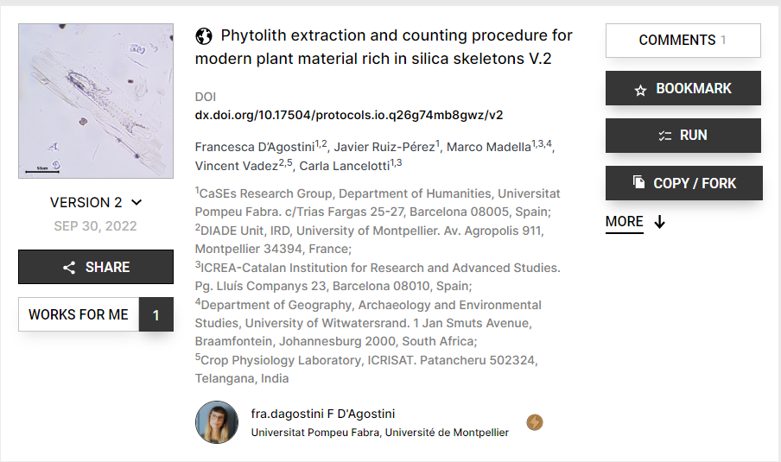
Using Protocols.io
Gives a DOI
This is a repository for archiving methods
Versions

Slide 45
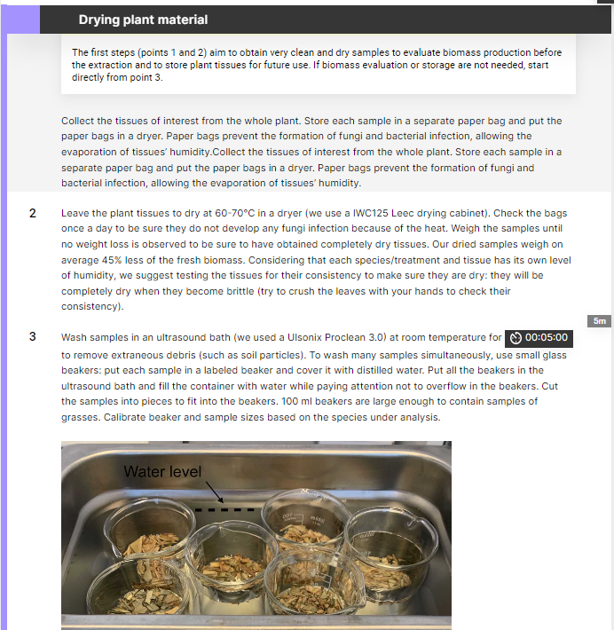
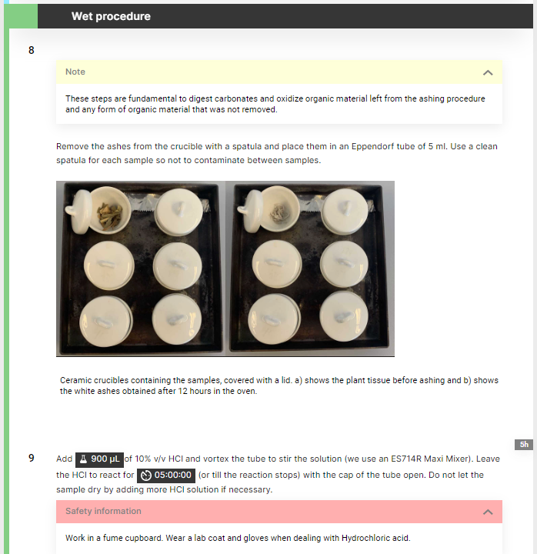
https://dx.doi.org/10.17504/protocols.io.q26g74mb8gwz/v2

Slide 46
Steps towards open and accessible publishing
Make it open access
What is the best method for you?
1
2
Deposit your data in a repository
Accessible research
papers
3
Deposit your code in a repository
4
Deposit method in a repository
5
Link data and code in article
Cite
Data & Code availability statement
Notes:
Next you need to link the data and code to your article

Slide 47
Link data and code in article
Tell others where your data and code are and how to find, access and reuse them.
Cite your data, code, method in the article
Write a clear data/code availability statement

Slide 48
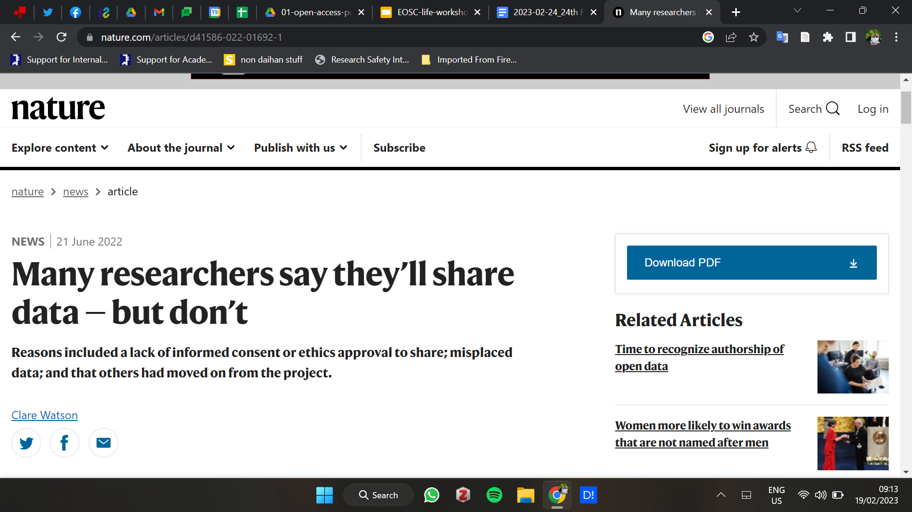
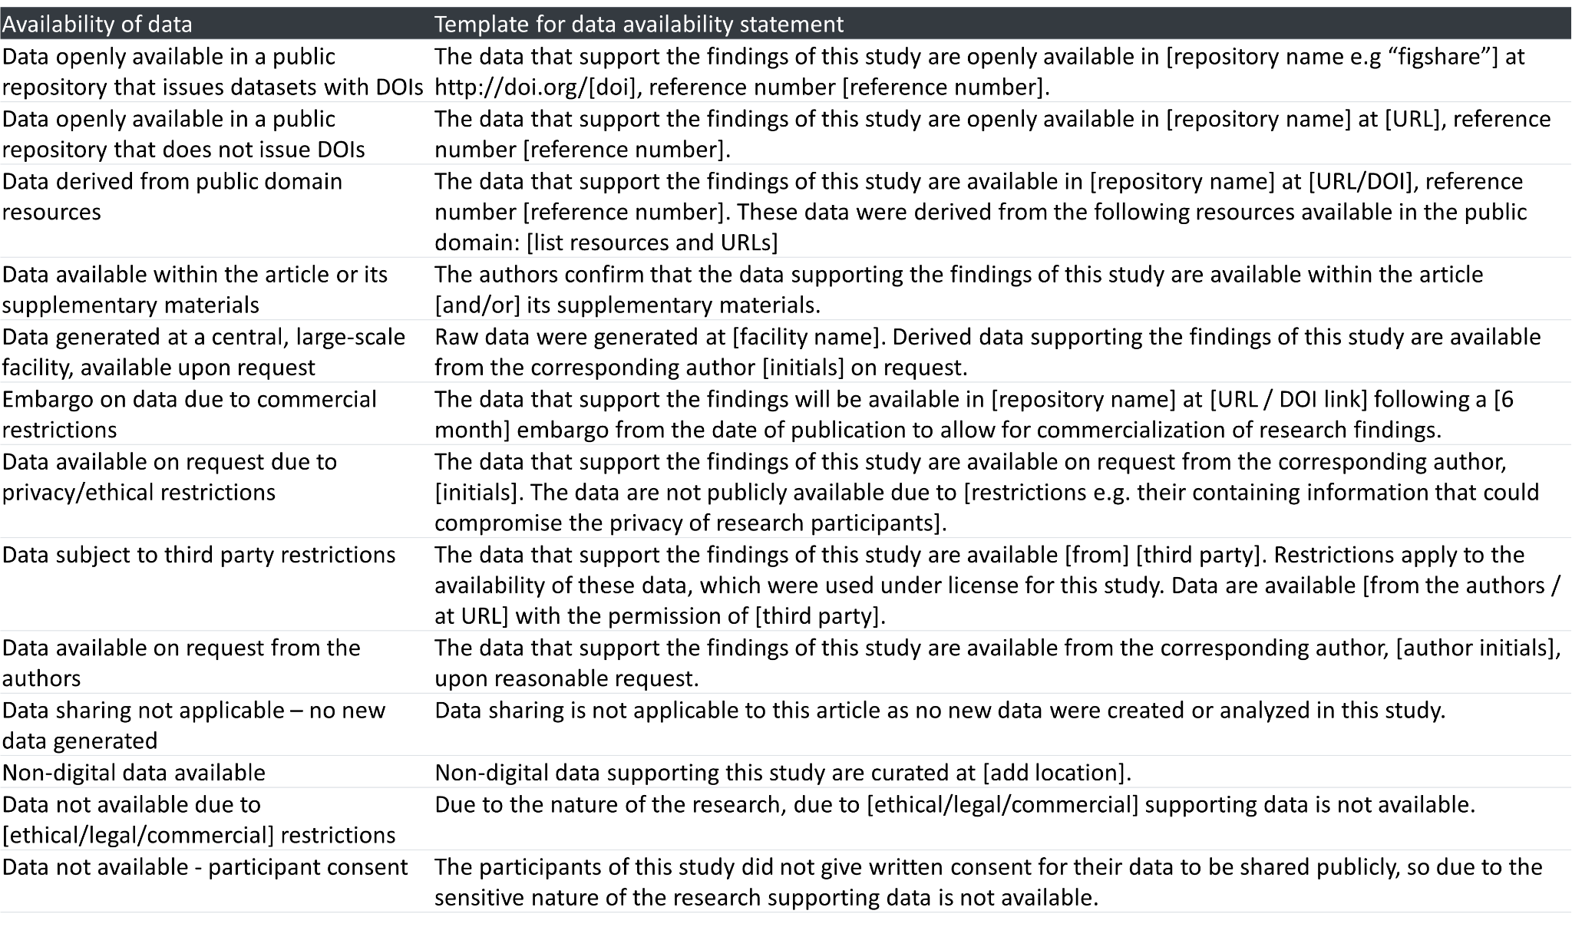
Data availability statements
Nature 606, 853 (2022)
doi:https://doi.org/10.1038/d41586-022-01692-1
Notes:
Find article that says people don’t give out their data when asked - DONE
A data availability statement (also sometimes called a ‘data access statement’) tells the reader where the research data associated with a paper is available, and under what conditions the data can be accessed. They also include links (where applicable) to the data set.
There are some basic ways to do a data availability statement and what you put i it should match what you are willing to give out!
include your data availability statement within the text of your manuscript, before your ‘References’ section. So that readers can easily find it, give it the heading ‘Data availability statement’.
Generally find templates - these are from Taylor and Francis - but are universally useful and can be modified as needed.
EXAMPLE - need to make sure you tailor it to the type of availability of data (and your willingness and your ability to actually provide the data) - Data openly available in a public repository that issues datasets with DOIs
“The data that support the findings of this study are openly available in [repository name e.g “figshare”] at http://doi.org/[doi], reference number [reference number].”
Versus:
Data not available - participant consent
“The participants of this study did not give written consent for their data to be shared publicly, so due to the sensitive nature of the research supporting data is not available.”
if you are submitting to a journal where submissions are c, then the main text file should not include any information that might identify the authors. As a data availability statement could reveal your identity, we recommend that you remove this from the anonymized version of the manuscript.
Check also the data policies - some may have different levels of data sharing policies and those guidelines will let you know what you need to do.

Slide 49
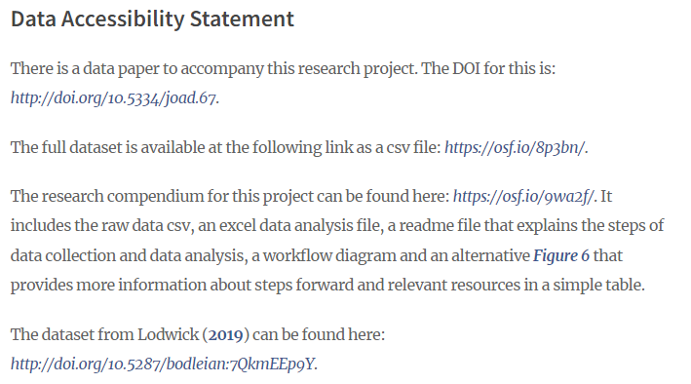
What they look like
Link to another paper
Link to data
Link to methods, analysis & documentation
Link to someone else's data used in this paper

Slide 50
Steps towards open and accessible publishing
Make it open access
What is the best method for you?
1
2
Deposit your data in a repository
Accessible research
papers
3
Deposit your code in a repository
4
Deposit method in a repository
5
Link data and code in article
Cite
Data & Code availability statement
6
Write data, methods articles
Notes:
Making these fully open articles may not be possible for you at the moment so there are different steps that you can take to move towards becoming more open access.
Make all articles open access in some way - so this could be to pay the apc for gold open access or by putting a version of your peer reviewed articles on an open repository.

Slide 51
Other types of articles
You might want to publish parts of your research as a separate article to create a more transparent and open record of your research.
Pre-registrations and registered reports
Data papers
Software papers
Methods papers

Slide 52
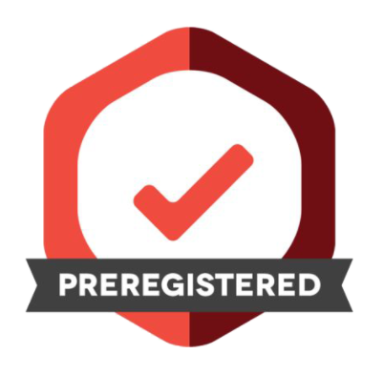
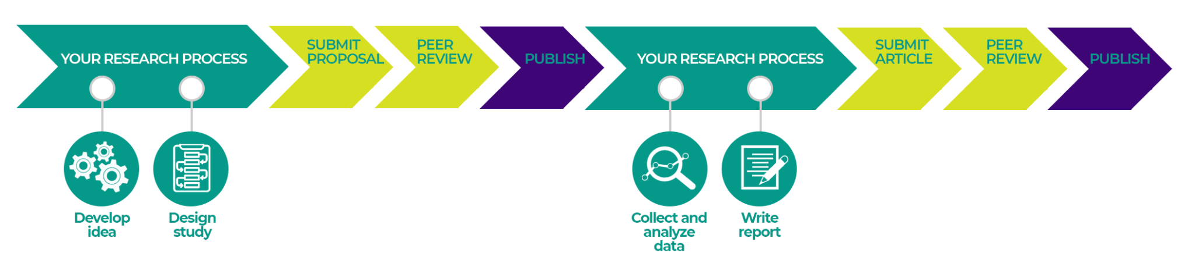
Pre-registration and registered reports
These articles explain what you intend to do in your research project
Include:
Hypotheses
Methods
Intended analyses

Slide 53




Data papers
Describes a dataset
Does not include analysis or findings
Data usually in an open repository
Use a template to write it
Data journals

Slide 54
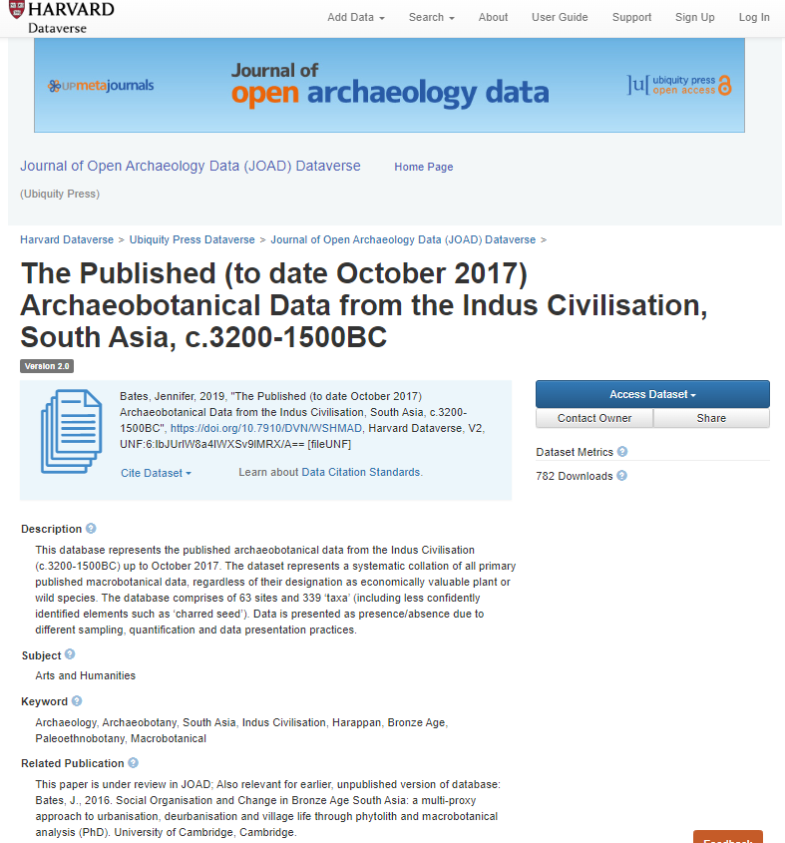
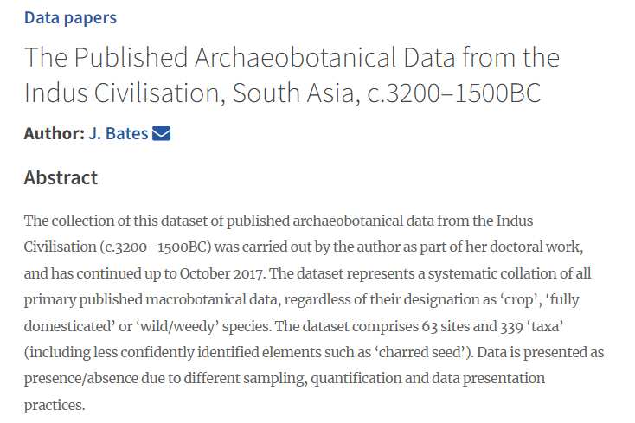
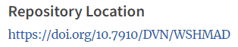
Example of data paper

Slide 55
Steps towards open and accessible publishing
Make it open access
What is the best method for you?
1
2
Deposit your data in a repository
Accessible research
papers
3
Deposit your code in a repository
4
Deposit method in a repository
5
Link data and code in article
Cite
Data & Code availability statement
6
Write data, methods articles
Notes:
Making these fully open articles may not be possible for you at the moment so there are different steps that you can take to move towards becoming more open access.
Make all articles open access in some way - so this could be to pay the apc for gold open access or by putting a version of your peer reviewed articles on an open repository.

Slide 56
Examples of open access publishing
Bates et al. 2017 - https://doi.org/10.1016/j.jas.2016.04.018
Bates and Petrie 2016 - Man and environment.
Karoune 2022 - data linked and documentation - http://doi.org/10.5334/oq.88
D’Agostini et al. 2023 - linked data, code and method https://www.sciencedirect.com/science/article/pii/S0034666722001816
Wang & Marwick 2020 - Executable research article - https://doi.org/10.1016/j.jasrep.2020.102554

Slide 57
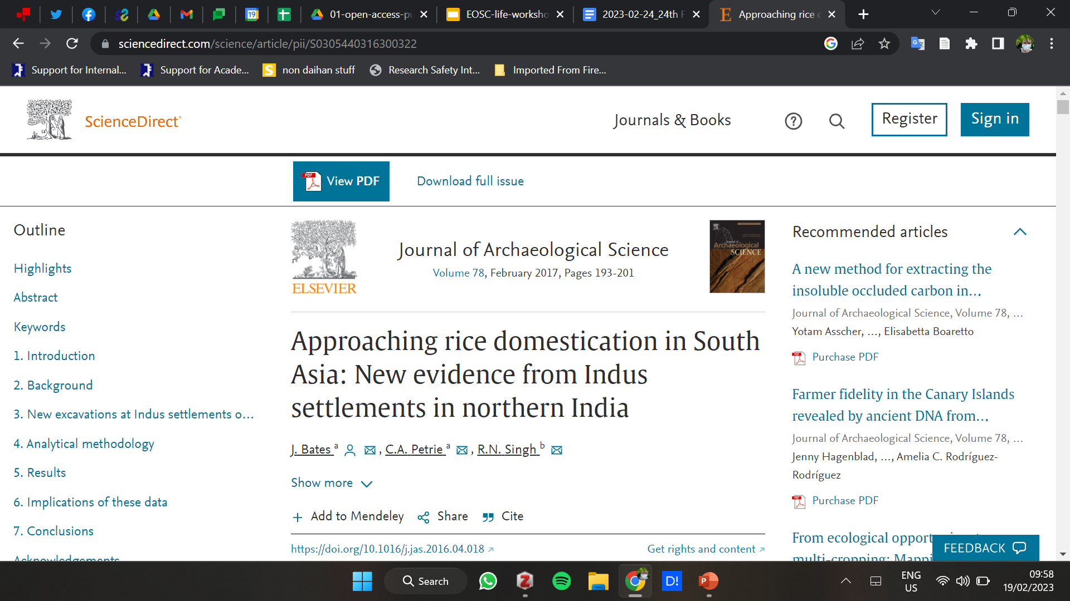
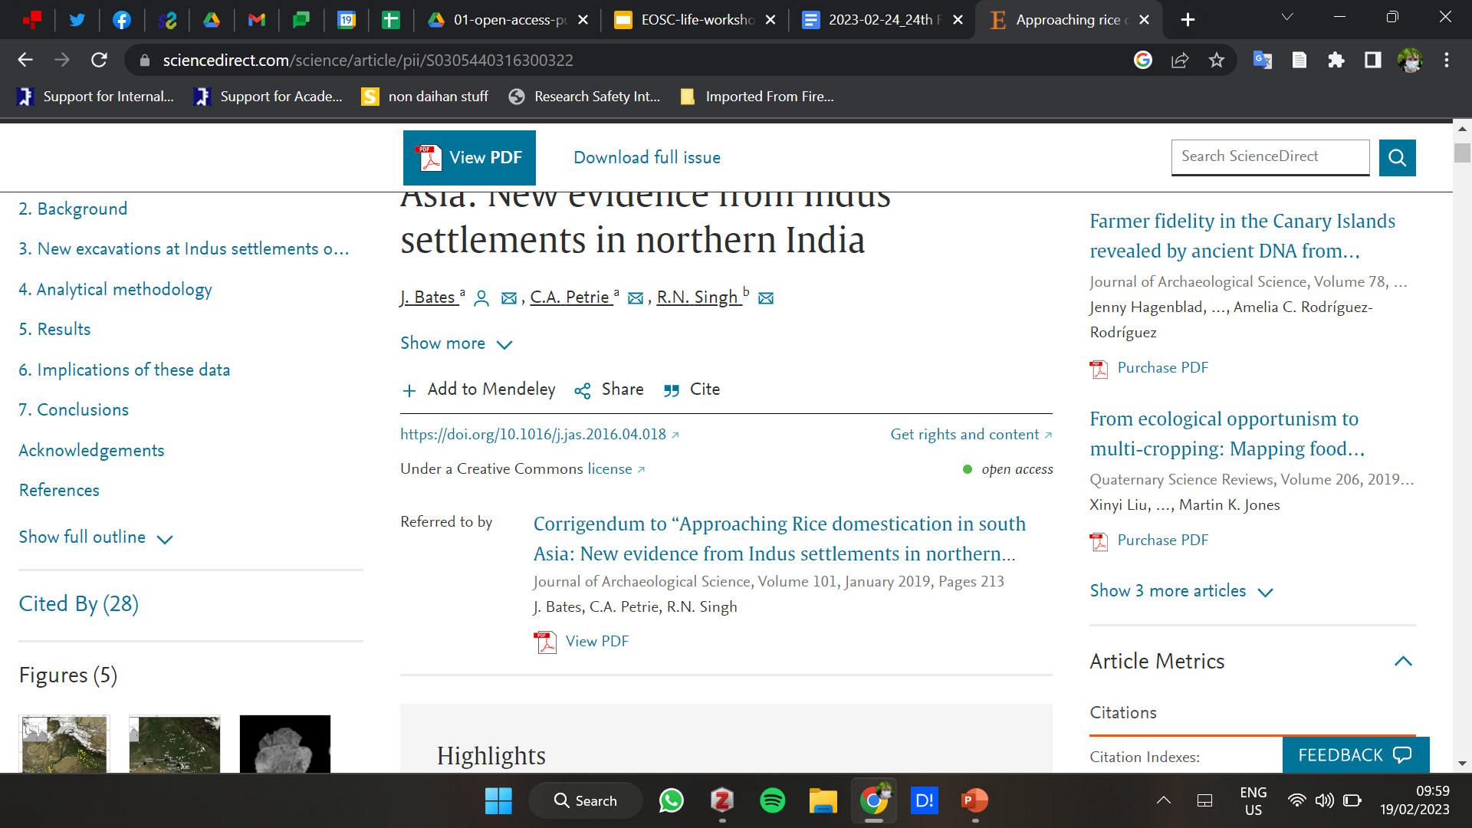
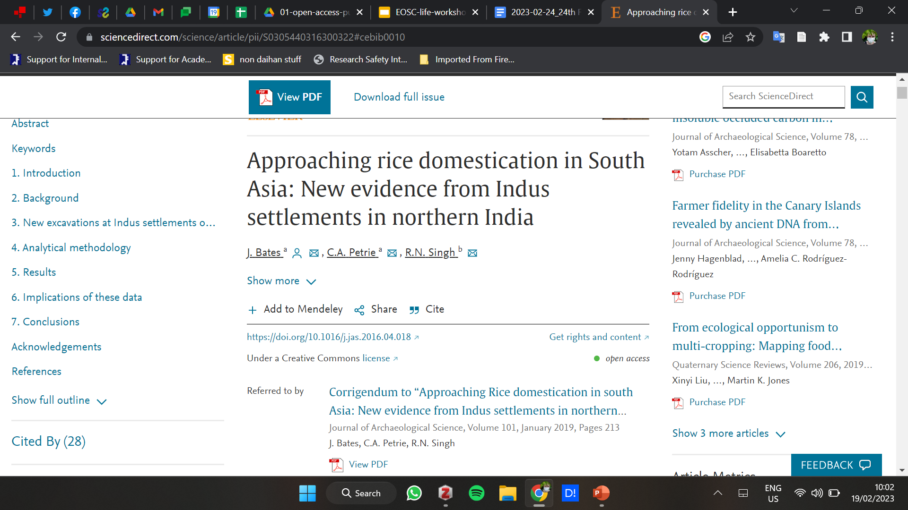
The authors confirm that the data supporting the findings of this study are available within the article
Notes:
And just to show that we’re not picking on anyone in particular as good/bad - an example from our own work that is not exactly the best.
Diamond - agreement between Cambridge and the journal. - this is not diamond - it’s some sort of transformative deal and counts as open access.
BUT we had to add a corrigendum as we forgot to put the funding info in correctly…
Data was put in summary tables in the main text, without reference to the full raw data from the site, which is terrible practice, but regardless that, there’s no data availability statement, and it should read something like “ The authors confirm that the data supporting the findings of this study are available within the article”

Slide 58
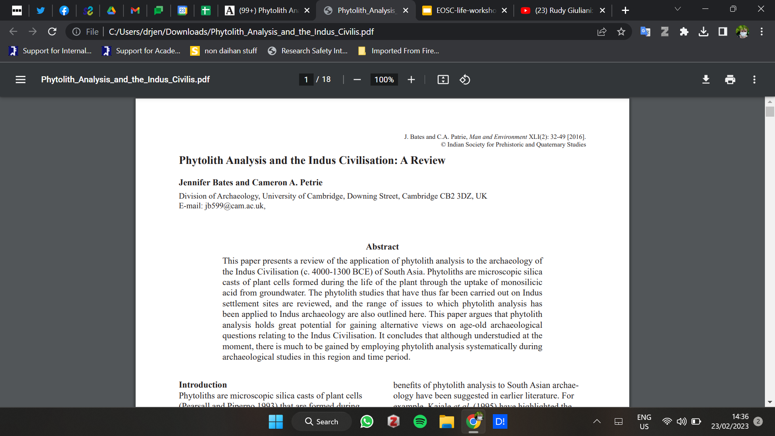
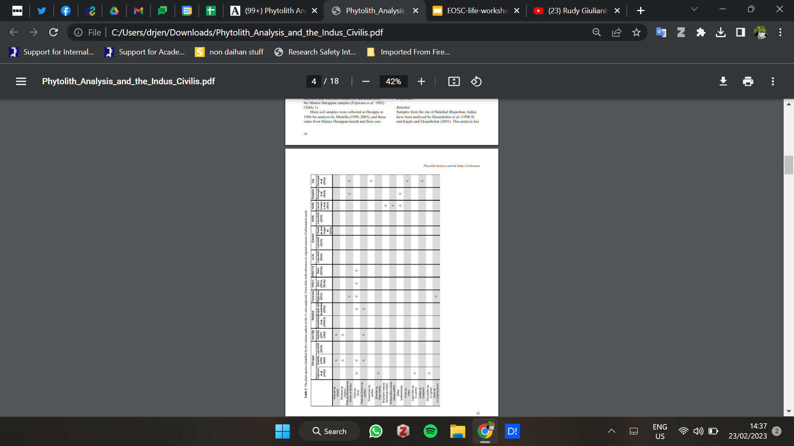
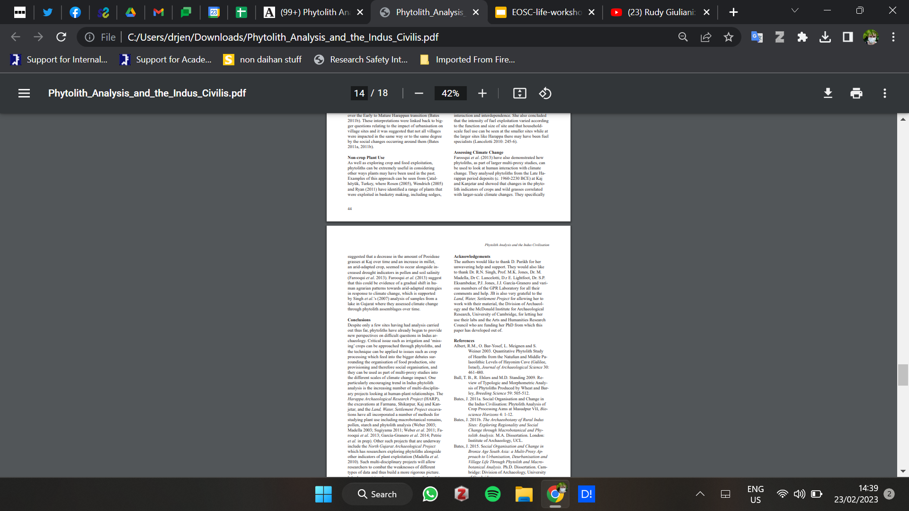
Notes:
Example of where necessity of not open access - permits, and/or need for being in national print only runs.
HOWEVER, SI could have been made rather than data tables in text, data could have been repository.
No data availability statement - could read “The authors confirm that the data supporting the findings of this study are available within the article. These data were compiled from published and publicly available sources which have been cited within the paper.”
Potentially make a separate repository SI with those in and cite it as an additional DOI.

Slide 59
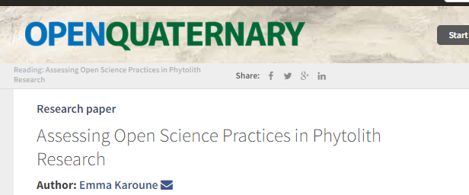
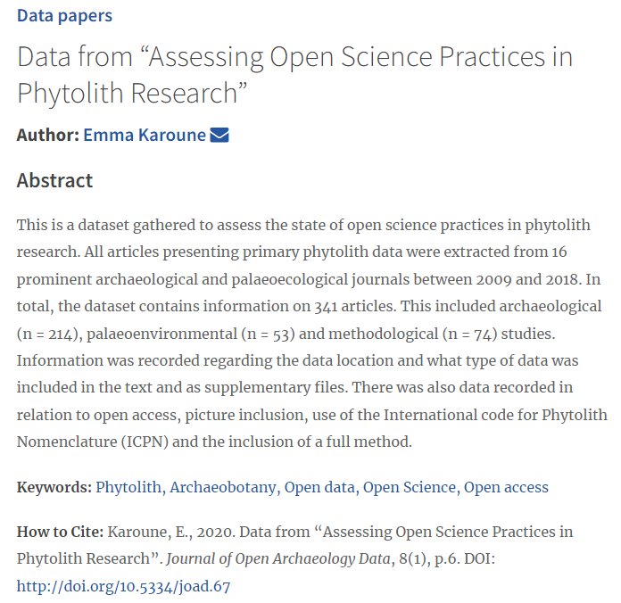
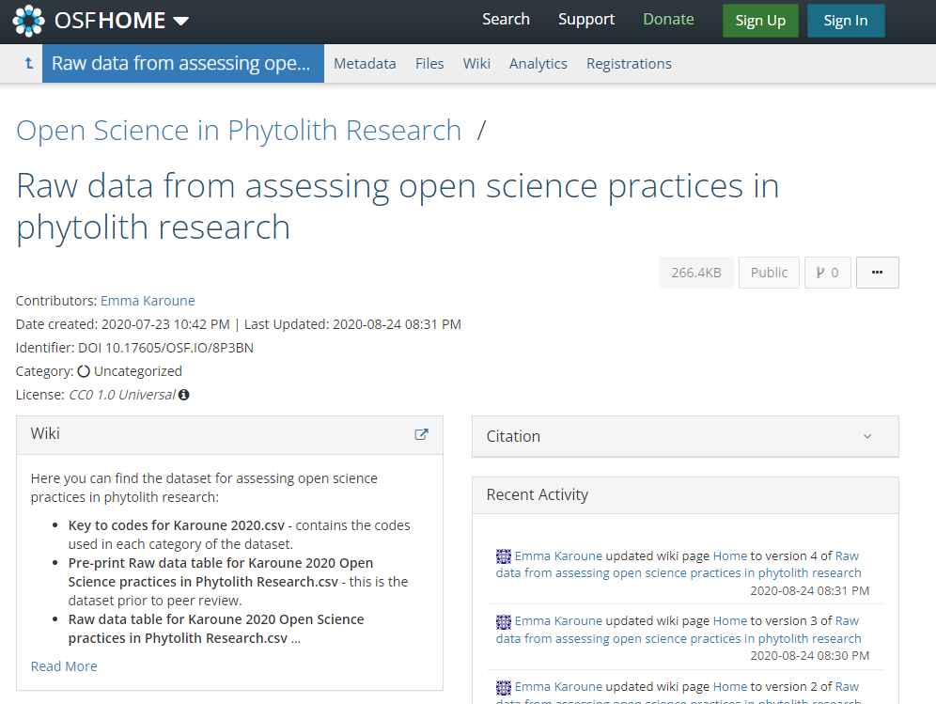
Karoune 2022
http://doi.org/10.5334/oq.88

Slide 60





https://doi.org/10.1016/j.revpalbo.2022.104783
Also method on protocols.io - http://dx.doi.org/10.17504/protocols.io.q26g74mb8gwz/v2
Notes:
Francesca D’Agostini - article - https://www.sciencedirect.com/science/article/pii/S0034666722001816
It is gold open through University’s agreement with publishers - a transformative agreement
Data statement placed by journal here - it does have supplementary word document but also link to other outputs.
The multiple links to places data stored which is CRITICAL as data link to github not working! Having it in two places is really useful!
It also has protocol io method - the one shown before. - http://dx.doi.org/10.17504/protocols.io.q26g74mb8gwz/v2

Slide 61


Executable research article
Green open access
Execute the data/code directly in an online environment
Notes:
https://github.com/LiYingWang/kwl.pottery

Slide 62
Questions????
Please put your hand up or write your question in the chat or shared document.

Slide 63
Explore and discuss
Take a look at the example articles
Discuss which bits you might be able to do now
Discuss what might be a barrier to you doing any type of open access shown in these examples
How would permits and funding affect your open access publishing?
What changes does this make to your publishing plans going forward?

Slide 64

The AEA Virtual Spring Conference will be taking place online on 13 May 2023, with optional Basic R training sessions on 14 and 15 May 2023.
Call for papers: https://forms.gle/MBQ7gLaqzU9opZLe7
Deadline 31 March 2023

Slide 65
Connect with us!
Open Phytoliths Community Launch Event
Please join our Slack workspace here: https://join.slack.com/t/openphytoliths/shared_invite/zt-1akxgco84-cz4Dii0Q5gXeb9J49UgYoQ
Join our mailing list: complete this form.
Take a look at our NEW multi-lingual website!: Open Phytoliths (open-phytoliths.netlify.app)
We are also on twitter (Open Phytoliths (@open_phytoliths) / Twitter) and facebook (Open Fitolitos | Facebook)!
📧📧📧
💻💻💻
Notes:
Thanks for listening and please do connect with us on slack, join our mailing list, take a look at our website or follow us on twitter or facebook.

